Slide 1

Introduction
Nutrition, Exercise and Disordered Eating in Substance Use and Recovery: An Interdisciplinary Approach
Anne R. Lindsay, PhD, FACSM
Professor, Extension Specialist
University of Nevada Reno, Extension
Notes:
Welcome to the Mini-Series: Nutrition, Exercise and Disordered Eating in Substance Use and Recovery: An Interdisciplinary Approach. My name is Dr. Annie Lindsay and I am a Professor at the University of Nevada Reno with an Extension appointment which focuses on basic and applied research and community-based programming efforts. I am the lead author and editor of this mini-series. I will introduce my colleagues later on.

Slide 2

Health care providers can no longer ignore common drug and alcohol disorders in their patients
Notes:
Physicians and health care providers often ignore common drug and alcohol disorders in their patients, rather than screen, detect, prevent, treat and/or refer them. Likely attributed to lack of training and maybe personal bias, this prevents or even obstructs the quality of care for patients with drug and alcohol concerns. Since patients and managed care providers are looking to physicians for leadership and to advocate for the patients, there is a need for medical schools and health care educators to provide training, education and opportunities for clinical experiences in addiction if possible.
This mini-series will examine the development and treatment of substance use disorders, highlight distinctions between mild and moderate-to-severe presentations and explore the prevalence and impact of comorbid conditions within this population. Emphasis is placed on a range of treatment approaches, including social support systems, counseling interventions, medication-assisted therapies, nutrition, exercise and will address co-morbidity with substance use including malnutrition and eating pathology.

Slide 3
What does a patient/client look like who may be using drugs or has a history of drug use?
Notes:
I’m going to start by laying the landscape for this series. Let’s begin with this question.
What does a patient/client look like who may be using drugs or has a history of drug use?
Take a few seconds and jot it down or if you prefer you can just think about it. If you're really being honest with yourself it's going to look different for every single one of us.

Slide 4
Explicit vs Implicit Bias
Explicit Bias
Aware of Bias
Express Directly, Conscious
Implicit Bias
Unaware of Bias
Express Indirectly, Sub-conscious
Blair IV et al. (2011) Perm J.15(2)
Notes:
The obvious answer is - we don’t really know but we often attach a face, a look, a feeling or an attitude to that individual. We all have some biases and often believe that we can pick out patients with addiction.
Stigma is a negative social attitude we attach to someone with addiction and it can lead to stereotyping, prejudice, and discrimination. This not only harms the person emotionally but doesn’t allow them to get the care they need.
Our biases can be explicit (conscious or directly expressed) because we are aware of those biases.
Or they can be implicit (not consciously aware or expressed indirectly). Meaning, we have internalized stereotypes that affect our perceptions without us being conscious of it. These are often based on our upbringing or past and current life experiences.
Sometimes, even in our best attempts not to hold biases, we might still possess these hidden unconscious biases.
Can you think of an example of an explicit and implicit bias in a health care setting that is related to substance use? Please jot it down.

Slide 5

Explicit and Implicit Bias
Explicit Bias
ER Doctor:
Tells the clinical staff, “Send him away, don’t give him a medication refill, he is an addict” without ever having evaluated the patient
Implicit Bias
ER Doctor:
Spends less time on a patient with a known history of addiction; doesn’t believe any care will matter
Notes:
Here are some I came up with…..
Explicit bias would be refusing a medication refill without assessing a patient because he is an addict and feels confident that they will misuse the medication.
First of all, the statement uses 1st person language and should always be expressed as 3rd person language. For example, a person with an addiction instead of addict. Secondly, it is explicitly bias to deny a medication refill without providing an evaluation.
For implicit bias, spending less time with a patient who has a known history of addiction because you don’t believe any thing said or done during the appointment will matter. Even though the 3rd person language is appropriate, subconsciously you may choose to not to provide adequate care for someone because of their known addiction.
For more information from NIDA about addiction and stigmatizing language, scan the QR Code.

Slide 6

Multiple Dimensions of Stigma in People with Substance Use Disorder
Self
(Internal)
Family &
Friends
Peers in Recovery
Criminal Justice System
Providers
Past History & Societal Norms
Adapted
Nock et al. (2023)
Notes:
In addition to provider biases, people with a SUD face multiple other dimensions of bias and stigma.
Starting with themselves. They are often their own worse critic. Stigma is Internalized by the person as a sort of self-deprecation due to feelings of shame and culturally-generated expectations.
It may also be Perceived or Anticipated based on past history of enacted stigma or societal norms.
They may have family and friends who might have lived with the person with the SUD.
Often time their peers in recovery can have biases based on the type of drugs used (feeling that one method of drug use is more or less shaming than another such as pills verses needles). Or how someone goes about recovery such as quitting cold turkey or use of methadone or some other drug to manage or treat their addiction.
People in the criminal justice system can be further harmed by staff, corrections officers, judges, lawyers, counselors, psychologists and psychiatrists who shame them, especially women who have young children placing a burden of shame such as being a bad parent.

Slide 7
Multiple Dimensions of Stigma in People with Substance Use Disorders
Self
(Internal)
Family &
Friends
Peers in Recovery
Criminal Justice System
Providers
Past History & Societal Norms
Inactivity
Eating Pathology
Overweight/ Obesity
Malnutrition
Pearl & Puhl (2018)
Simone et al (2019)
Adapted
Nock et al. (2023)
Notes:
In addition to biases related to SUD, there are biases related to many of the comorbid conditions such as eating pathology, overweight or obese, malnutrition, inactivity, etc.
Healthcare professionals including physicians, nurses, psychiatrist, psychologists, and dietitians hold biased attitudes and beliefs about obese or overweight patients which is a common side effect of recovery. They often characterize large bodies as unmotivated, non-compliant, and blame them for their weight or levels of inactivity or unhealthy diet. This makes it more difficult for these patients to seek or receive adequate medical attention.
Research also suggests that individuals who are overweight are less likely to be diagnosed with eating pathology, take longer to get assessed or treated, and may be simply encouraged to diet by their healthcare professionals which decreases the likelihood that patients will engage in health promoting behaviors such as exercise, healthy eating, and nutrition education.
Increased stigma and decreased self-efficacy ultimately increase the risk of developing or intensifying existing mental health symptoms such as depression, anxiety, weight concerns, binge eating and purging -- prolonging their recovery from substance use.
Pearl & Puhl (2018). Weight bias internalization and health: a systematic review. Obesity reviews: An official journal of the International Association for the Study of Obesity, 19(8), 1141–1163. https://doi.org/10.1111/obr.12701
Simone et al (2019). Unhealthy weight control behaviors and substance use among adolescent girls: The harms of weight stigma. Social science & medicine (1982), 233, 64–70. https://doi.org/10.1016/j.socscimed.2019.05.047

Slide 8
Our goal is not to change people but to help people with change
Diet Quality
Food Resources
Nutrition & Feeding
Family Meal Planning
Eating on a Budget
Physical Activity
Social Recreation
Lifestyle Skills
Detoxification
Assessment
Counseling
Behavioral Therapy
Co-Occurring Disorders
Medication
Intervention
Whole Person
Abstinence
Cravings/Triggers to Prevent Reoccurrence
Employment
Family Reunification & Parenting
Housing
Food Security
Relationships
Notes:
As various medical and mental health professionals, we all have a unique and different role in their recovery as we each hold a different expertise that contributes to the larger recovery process. We bring our expertise, not to change people, but to help people WITH change as they navigate their own journey.
Even abstinence is not a singular point in time that's defined by success or failure, it is all part of the journey. Recovery is a dynamic process. It is an ongoing pursuit, occurs over time and there are varied pathways to get there.
And though there is often a disconnect between medical professionals and those serving the substance use community, it may stem from a desire to stay within one’s scope of practice. But it can weaken the collaborative and holistic approach to recovery.

Slide 9
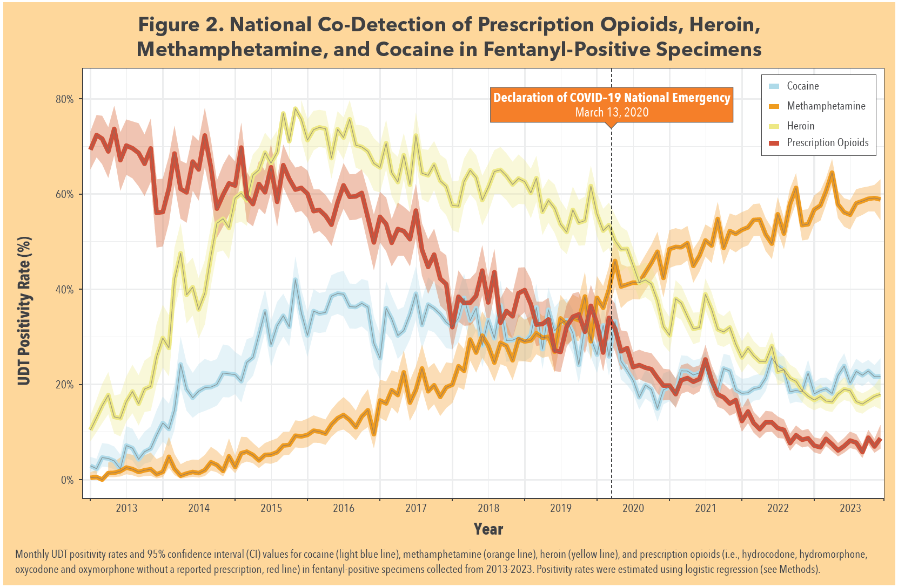
Fentanyl Detection in Various Substances
Millennium Health, 2024
Notes:
While we have seen waves of substance use and overdose deaths across several decades that involve opioids and synthetic opioids such as fentanyl, it's important to understand that some of those deaths classified as “overdoses” may have actually been “poisonings” since many street drugs are commonly laced with street fentanyl. Which btw can be 100 times the potency of heroin.
As you can see here, methamphetamine and cocaine were both co-detected in fentanyl-positive specimens with MA detected in 60% of cases. And I might point out, there is (to date), no FDA-approved pharmacotherapy for MA dependence which underscores the need to further develop interventions and provide adequate health care to be able to recognize, identify and treat the symptoms.

Slide 10

Social & Human Capital
Lower socioeconomic status
Often unemployed, lower pay
Less education
Decreased self-efficacy
Home care and family responsibilities
Lack of child support
Childcare expensive
Lack of family support
Social and legal fears (loss of children)
Greater health consequences from SUDs
Reproductive age complications
History of trauma
Office Women's Health
Notes:
While every race and ethnicity is impacted by substance use, we see higher rates within minority populations, especially American Indian, Alaskan Native. And while men use substances at a higher rate than women, women are rapidly outpacing men. Especially women of reproductive age (15-44) who often use a polysubstance (or more than one drug as their primary drug). More specifically, they use stimulants and CNS depressants as the 2 drugs work synergistically to bring the individual up and then back down (NIDA).
So why is there such a rise in young females, especially those of reproductive age. The biggest known factor is they generally lack social and human capital which play largely into creating treatment barriers.
READ LIST
SOCIAL AND LEGAL FEARS - In many states, pregnant women or women with children can be reported to child protective services for using illicit drugs. Which is why involvement with the child welfare system plays a critical role in a woman’s decision to seek care, because admitting to a substance use disorder may lead to loss of custody. So they often do not get the help they need including prenatal care.
GREATER HEALTH CONSEQUENCES AND REPRODUCTIVE AGE COMPLICATIONS:
Hormones
Menstrual cycle
Fertility
Pregnancy
Breastfeeding
Menopause
And finally, HISTORY OF TRAUMA – a lifetime of trauma history (mostly childhood occurrence) was found in 55% to 99% of women who misused substances, compared with rates of 36% to 51% in the general population
Knowing this, we need to adjust our treatment and educational strategies related to SUD.

Slide 11
Women & Substance Use
Women use different drugs than men
Females respond to drugs differently than males
Women use drugs for different reasons than men
Women relapse for different reasons than men
National Institute of Drug Abuse
Notes:
Other reasons for ensuring this gender responsive treatment is that we know
First, women use different drugs than men (we saw that the polysubstance use of stimulants and heroin are very popular in women)
2nd, biologically, female bodies respond to drugs differently than male bodies (the drugs manifest differently in their bodies). For example, females are more vulnerable to the reinforcing (rewarding) effects of drugs like stimulants. Another example, studies show females use smaller amounts of OPIOIDS for a shorter period of time before becoming dependent.
And, finally, women use drugs and relapse for different reasons than men

Slide 12
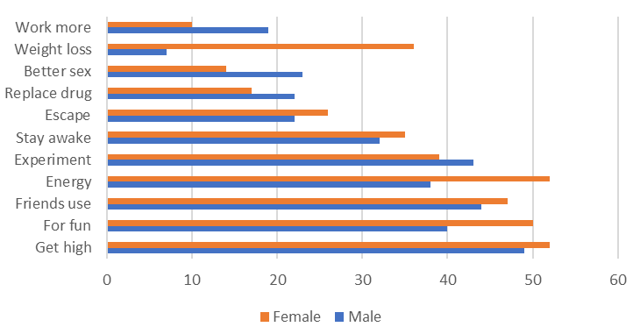
Motivators for Methamphetamine Use
Men
Women
Brecht, 2004
Notes:
So, what is the draw for stimulants like methamphetamine in women?
Increases in…
Mood/euphoria
Confidence
Energy
Metabolism
Alertness
AND Decreases in
Appetite
Boredom
Loneliness
Timidity
Amount of sleep needed
In comparison to men, women have different motivators. This seminal study out of UCLA shows the top 2 reasons women report using stimulants is for weight loss and energy. For men, they reported to work more and have better sex.

Slide 13
Weight-related concerns:
Women in treatment for substance use
(Nevada; n = 297)
Concerned about weight while in recovery? 71%
Concerned that gaining weight could trigger relapse? 45%
Concerned about using to lose weight after treatment? 30%
Warren, Lindsay, et al 2012
Notes:
And because women often gain weight when they stop using stimulants, that becomes yet another treatment barrier.
A women's weight status is generally not just a metric of her health, but is often conceptualized as a metric of her self-worth and societal value. Furthermore, this weight gain can cause depression and inability to regulate mood. Equally important, nearly half of the women we surveyed, reported gaining weight could be a trigger for relapse.
So then dieting often becomes a form of self-medication (even encouraged by their physician) leading to very restrictive eating, fad dieting trends, dieting products and supplements (which are not regulated by the FDA btw), and use of energy products known to be a gateway back to SU as they can mimic the highs and lows of certain street drugs.
These dieting trends have a negative impact on body image, and lead to general psychological maladjustment, interpersonal and affective problems, poor impulse control, and difficulty discriminating between and regulating moods --- which will ultimately further harm their recovery.

Slide 14
Post Acute Withdrawal Symptoms (PAWS) Early Intervention
Post-Acute Withdrawal Symptoms
Group Health INTERVENTIONS
Melemis, 2015
Swings in mood
Anxiety
Energy variation
Irritability
Low level of enthusiasm
Concentration (variable)
Sleep disturbances
Nutrient replacement
Physical activity
Energy
Increased metabolism
Promotion of well-being
Focus and concentration
Better Sleep
Relapse rates are:
40-60% within 30 - 90 days
(NIDA)
75-95% within 1 year
(across various studies depending on the substance)
Notes:
Early intervention is critical for people in recovery as relapse rates are 40-60% within 60-90 days and between 75-95% within the first year. Even recidivism for chronic disease isnt this bad. And yet studies show, that similar to common chronic diseases, significant impact of nutrition and diet quality extends to high-prevalence mental illnesses.
This diagram shows common symptoms (in orange) experienced by people immediately post withdrawal. Much of this is exacerbated by malnutrition which common to people with SUD. Substances can cause nutrient deficiencies, nutrient excesses and impaired utilization of nutrients.
So it seems early intervention, specifically the role nutrition and physical activity can play in recovery (seen on the right) could impact people in recovery in a very positive way.

Slide 15
Nutrition and Exercise Impacts on Abstinence
Alcohol, Stimulants, Opioids
Beta-Endorphins/Dopamine
Abstinence (early on)
Positively Impact Mood/Energy/Pain/Cravings
Exercise/ Nutrition
Adapted From National Institute of Drug Abuse
Notes:
To drive this point home, looking at the BLACK parts of the diagram, we can see (depending on the substance of use) the drug being used increases brain chemicals such as natural endorphins or neurotransmitters, including Dopamine.
These can positively impact mood and energy and decrease pain and cravings (again depending on the drug).
During abstinence , the RED parts of the diagram, we see everything reverses. The individual loses those brain chemicals and it negatively impacts mood, energy, pain and cravings.

Slide 16
Nutrition and Exercise Impact on Abstinence
Alcohol, Stimulants, Opioids
Beta-Endorphins/Dopamine
Abstinence (early on)
Exercise/ Nutrition
Positively Impact Mood/Energy/Pain/Cravings
Adapted From National Institute of Drug Abuse
Notes:
Finally, the GREEN part of the diagram shows how nutrition and exercise naturally increase those neurotransmitters and positively impact mental health.

Slide 17




Team for This Project
Ted Parran MD, FACP, FASAM
Medical Director, Rosary Hall, St. Vincent Health Center
Isabel and Carter Wang Professor in Medical Education
Case Western Reserve University, School of Medicine
Heather Norman-Burgdolf, PhD
Associate Extension Professor
Extension Specialist Health and Nutrition
Department of Dietetics and Human Nutrition
University of Kentucky
Nora L. Nock, PhD, PE, FSBM
Professor
Department of Population & Quantitative Health Sciences
Case Western Reserve University
Cortney S. Warren, PhD, ABPP
Board Certified Clinical Psychologist
Adjunct Professor, Department of Psychiatry
Kirk Kerkorian School of Medicine at UNLV
Notes:
So as we dig into this mini-series, I would like to introduce the rest of my esteemed colleagues and team of experts and authors of the mini-series in the order they will appear:
Dr. Ted Parran is a physician, Board-Certified in Internal Medicine and Addiction and Medical Director for St. Vincent Health Center. He is also a professor in Medical Education at Case Western Reserve University. He will discuss addiction excluding the development and treatment of substance use disorders, highlight distinctions between mild and moderate-to-severe disorder and share a range of treatment approaches.
Dr. Heather Norman-Burgdolf, is an Associate Professor and Extension Specialist in the Department of Dietetics and Human Nutrition at the University of Kentucky. She will discuss the role of nutrition in addiction and how substance use disrupts nutrient absorption and leads to malnutrition, highlights the critical roles of macro- and micronutrients in physical and mental recovery, and offers practical dietary strategies to enhance rehabilitation outcomes.
Dr. Nora Nock, is a Professor in the Department of Population & Quantitative Health Sciences at Case Western Reserve University She will discuss how exercise enhances abstinence and mental health in people with substance use disorders, the underlying neurobiological and cardiorespiratory mechanisms, and the importance of movement-based interventions.
And finally, Dr. Cortney Warren, is a Board-Certified Clinical Psychologist and Adjunct Professor in the Department of Psychiatry at the Kirk Kerkorian School of Medicine, University of Nevada Las Vegas. She will discuss the bidirectional links between eating pathology and substance use including diagnoses, comorbidities, while offering biopsychosocial, evidence-based strategies for integrated assessment and intervention.

