Slide 1
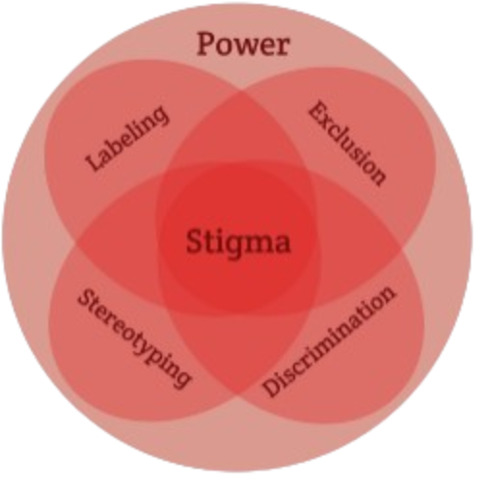
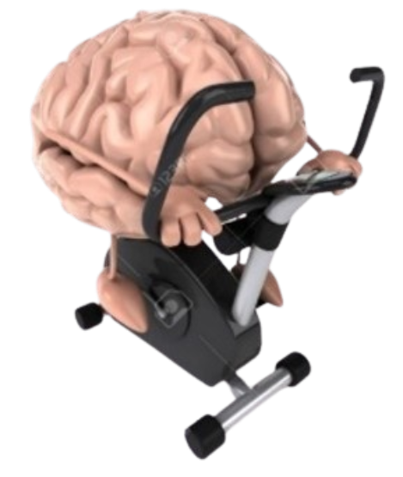


Exercise and Movement in People with Substance Use Disorders
Rural Opioid Technical Assistance Course
Pacific Southwest Region
Nora L. Nock, PhD, PE, FSBM
Professor
Department of Population & Quantitative Health Sciences
Case Western Reserve University
Notes:
-Welcome back to Exercise and Movement in people with substance use disorders

Slide 2
Module 5: Exercise and SUD: ACSM “Call to Action” and Summary
Notes:
- We are on the last module in this series

Slide 3
Call to Action Statement
https://journals.lww.com/acsm-csmr/abstract/2024/02000/exercise_as_medicine_for_people_with_a_substance.8.aspx
Notes:
because of the gaps in our knowledge regarding exercise in people with SUD,
we developed a Call To Action statement which was supported by the American College of Sports Medicine

Slide 4
ACSM “Call to Action”:
Exercise as Medicine for People with SUD
Highlight the need for additional larger and more rigorous studies to better understand the optimal “dose” and modalities of exercise
Acknowledge the need for updated guidance on exercise testing and specialized training for exercise professionals because of the potential physical and mental health comorbidities in people with SUD
Raise awareness to stigma associated with SUD and how it can negatively impact recovery
Highlight the need for developing a toolkit for community treatment centers to integrate exercise into recovery
https://journals.lww.com/acsmcsmr/abstract/2024/02000/exercise_as_medicine_for_people_with_a_substance.8.aspx
Notes:
The primary goals of this Call to Action were to highlight the need for additional larger & more rigorous studies to better understand the optimal “dose” & modalities of exercise
To acknowledge that specialized training for exercise professionals is needed because of the potential physical and mental health comorbidities
Including cardiomyopathy & other cardio-metabolic conditions arising from the use/misuse of substances
To raise awareness to stigma associated with SUD and how it can negatively impact recovery
Stigma will be discussed in more detail in other sections of this course

Slide 5

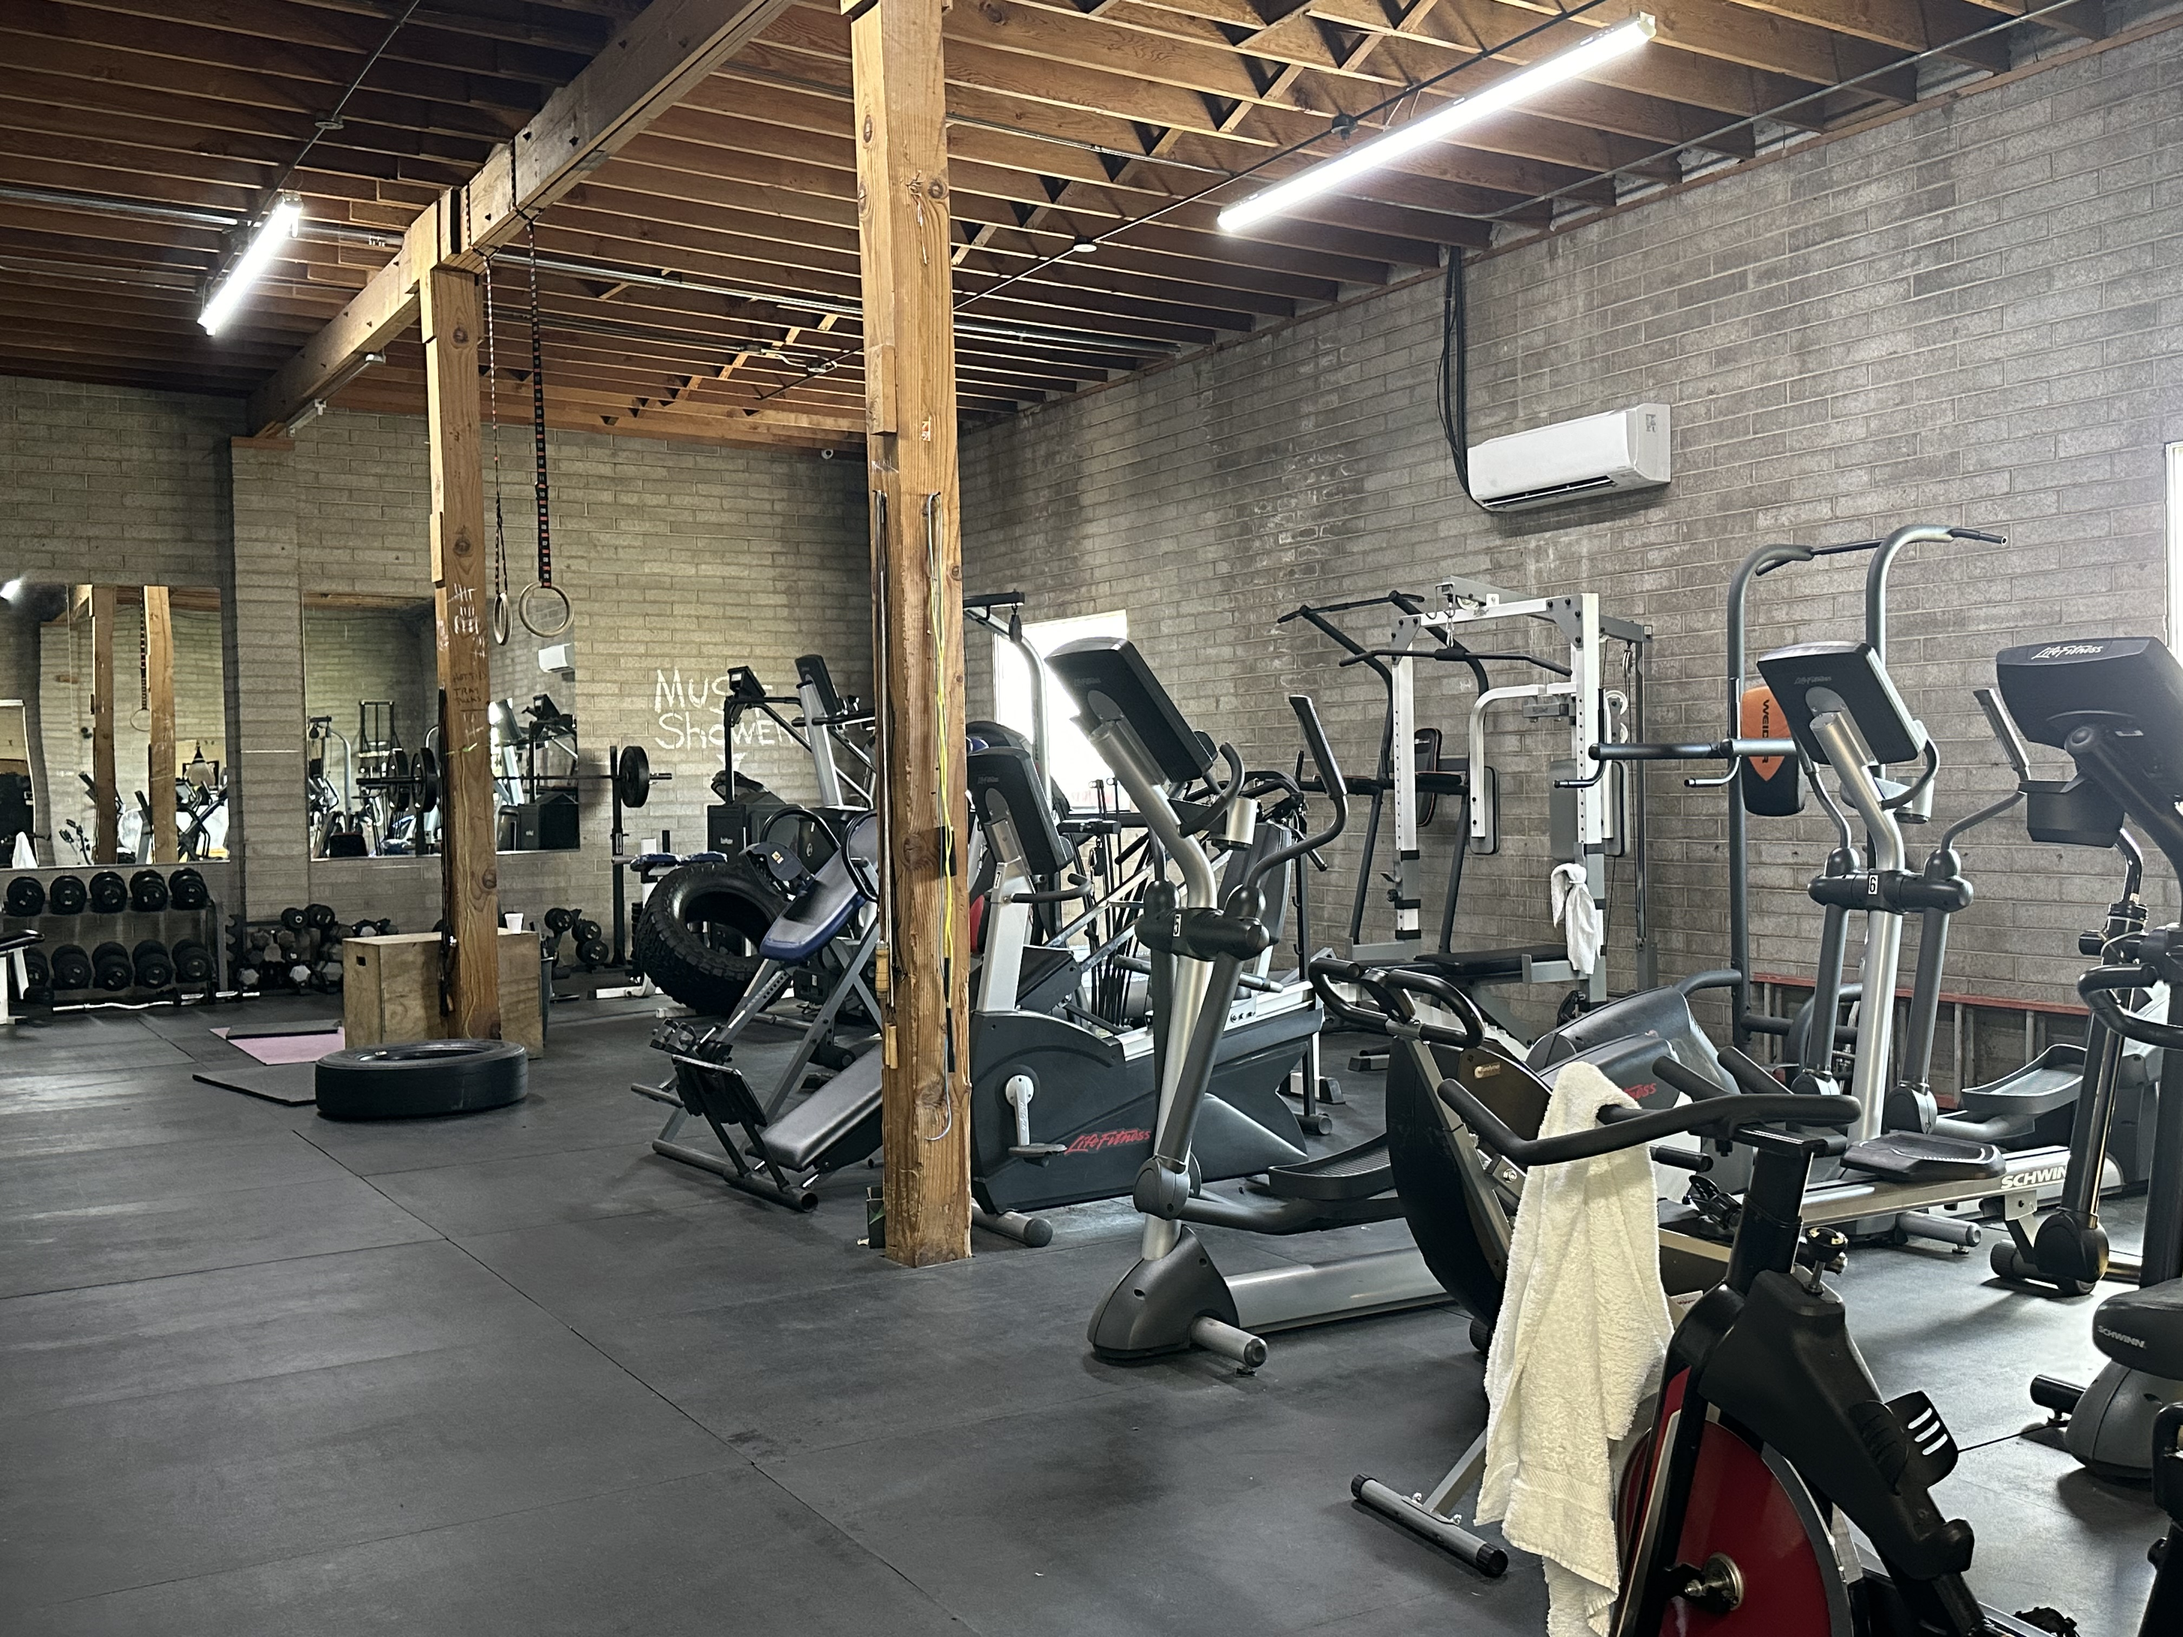
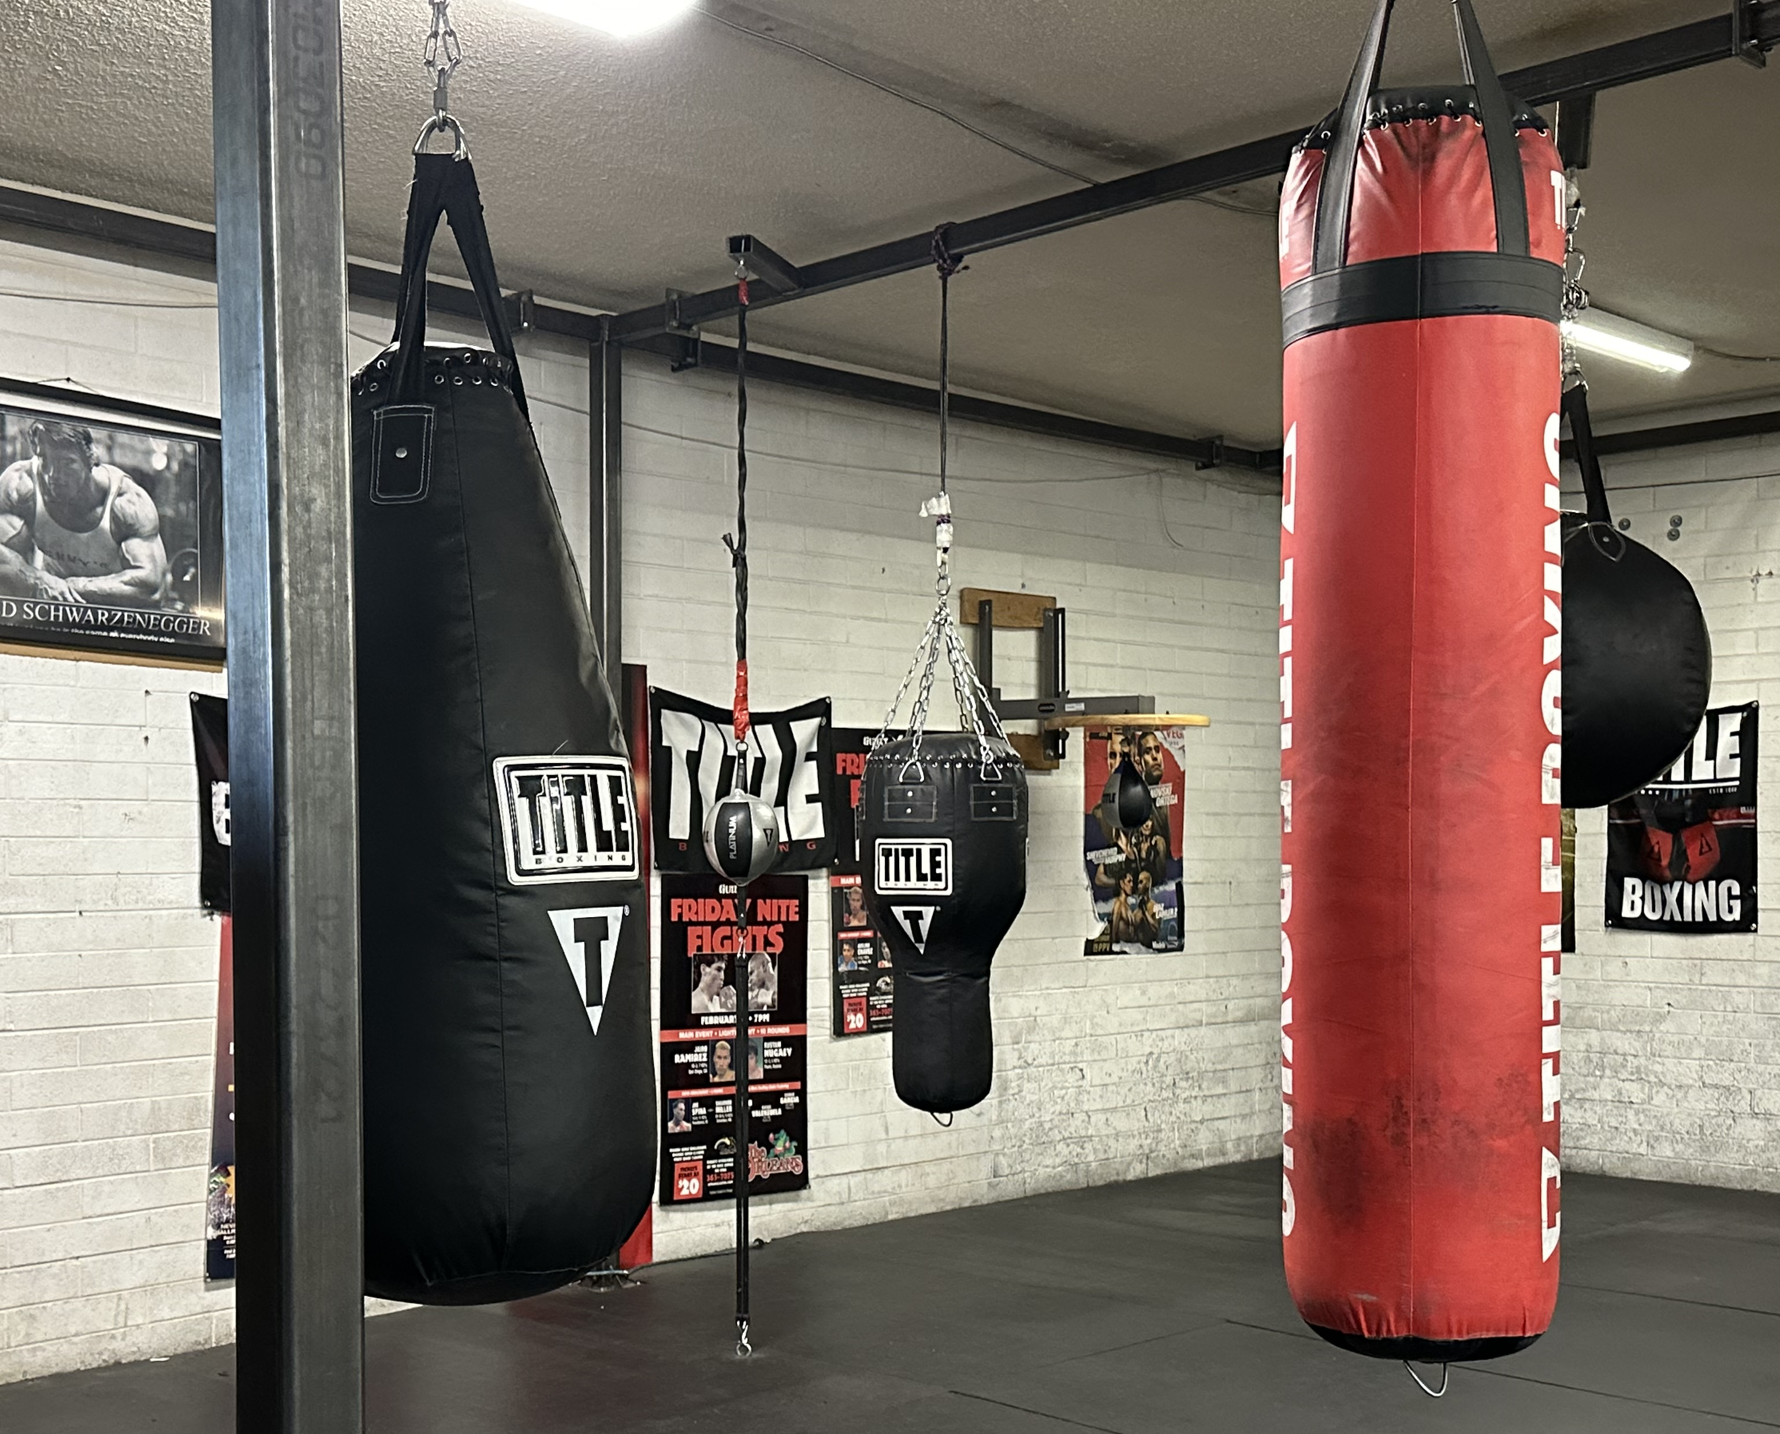

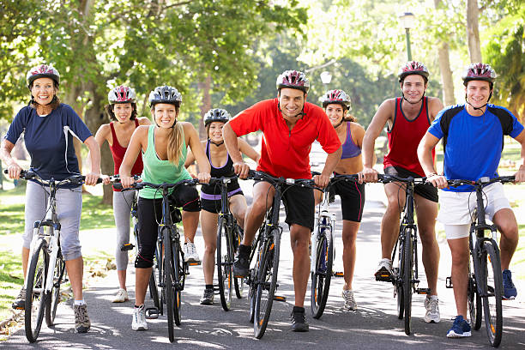
Mind-Body Exercises, Sports, Community Activity Programs and General Movement
Images from Microsoft 365 Stock Photos
Notes:
- Thus far, we haven’t differentiated between “exercise” or planned, structured physical activity and general movement
But all types of movement are beneficial!
Mind-body exercises, including yoga, Tai Chi, are among the most common exercise training programs in drug treatment facilities mainly because they do not require a lot of resources in terms of equipment & they provide additional cognitive and potentially spiritual benefits
Engaging in sports and community activity programs may also help connect people and enhance social engagement which can be particularly helpful during recovery

Slide 6
Summary: Benefits of Exercise in People with SUD: Similar to General Population ???
Lower risk of all-cause mortality
Lower risk of cardiovascular disease mortality
Lower risk of cardiovascular disease (including heart disease and stroke)
Lower risk of hypertension
Lower risk of type 2 diabetes
Lower risk of adverse blood lipid profile
Lower risk of cancers of the bladder, breast, colon, endometrium, esophagus, kidney, lung, and stomach
Improved cognition
Reduced risk of dementia (including Alzheimer’s disease)
Improved quality of life
Reduced anxiety
Reduced risk of depression
Improved sleep
Slowed or reduced weight gain
Weight loss, particularly when combined with reduced calorie intake
Prevention of weight regain following initial weight loss
Improved bone health
Improved physical function
Lower risk of falls (older adults)
Lower risk of fall-related injuries (older adults)
Notes:
- So the bottom line is although we do not know the optimal dose or types of exercise to precisely prescribe at this point,
There is enough evidence to suggest that people with SUD may benefit in much the same way or potentially in an even greater capacity than the general population
Thus, exercise should help decrease mortality and the risk of cardiovascular diseases and cancer in people with SUD
Exercise should also help improve depression, anxiety, sleep while improving physical function and fitness as well as cognition and bone health

Slide 7
Reference List
Wang D et al. (2014) Impact of physical exercise on substance use disorders: a meta-analysis. PLoS ONE 9(10): e110728
Zheng et al. (2024) Effect of physical exercise on emotional & cognitive levels of patients with SUD: a meta-analysis. Front Psychol. 15:1348224
Giménez-Meseguer et al. (2020) The Benefits of Physical Exercise on Mental Disorders and Quality of Life in Substance Use Disorders Patients. Systematic Review and Meta-Analysis. Int. J. Environ. Res. Public Health. 17: 3680
Lardier et al. (2021) Exercise as a Useful Intervention to Reduce Alcohol Consumption and Improve Physical Fitness in Individuals With Alcohol Use Disorder: A Systematic Review and Meta-Analysis. Front. Psychol. Vol. 12: 675285
Brown et al. (2016) An exploratory analysis of changes in mood, anxiety and craving from pre- to post-single sessions of exercise, over 12 weeks, among patients with alcohol dependence. Ment Health Phys Act. 11:1-6
Cabral, D. A. et al. (2024) The role of physical exercise on the brain and cognitive functions of patients in recovery from substance use disorder: A narrative review and recommendations for researchers and practitioners. Mental Health and Physical Activity, 100594.
Volkow ND et al. (2007). Dopamine in Drug Abuse and Addiction: Results of Imaging Studies and Treatment Implications. Arch Neurol. 2007;64(11):1575-1579.
Notes:
- Here is a list of references if you would like to dig deeper into any of these topics

Slide 8
Reference List
Cabral DA et al.(2024) The role of physical exercise on the brain and cognitive functions of patients in recovery from substance use disorder: A narrative review and recommendations for researchers and practitioners. Mental Health and Physical Activity, 100594.
Cooper C, Moon HY, van Praag H (2018) On the Run for Hippocampal Plasticity. Cold Spring Harb Perspect Med. 8(4):a029736
U.S. Department of Health and Human Services. (2018) Physical Activity Guidelines for Americans, 2nd edition. Washington, DC. Department of Health and Human Services
Nock NL, Minnes S, Alberts JL (2017) Neurobiology of substance use in adolescents and potential therapeutic effects of exercise for prevention and treatment of substance use disorders. Birth Defects Res. 109(20):1711-1729
https://health.gov/sites/default/files/2019-09/Physical_Activity_Guidelines_2nd_edition.pdf
https://www.acsm.org/education-resources/trending-topics-resources/physical-activity-guidelines
Bahorik AL et al. (2017) Alcohol, Cannabis, and Opioid Use Disorders, and Disease Burden in an Integrated Health Care System. J Addict Med. 11(1):3-9
Flemmen G, Wang E (2015) Impaired Aerobic Endurance and Muscular Strength in Substance Use Disorder Patients: Implications for Health and Premature Death. Medicine. 94(44):e1914
Notes:
- Here is a list of references if you would like to dig deeper into any of these topics

Slide 9
Reference List
Stoutenberg M, Rethorst CD, Vidot DC, Greer TL, Trivedi MH (2017) Cardiorespiratory fitness and body composition of stimulant users: A baseline analysis of the STRIDE cohort. J Subst Abuse Treat. 78:74-79
Fenn JM, Laurent JS, Sigmon SC (2015) Increases in body mass index following initiation of methadone treatment. J Subst Abuse Treat. 51:59-63
Peles E, Schreiber S, Sason A, Adelson M (2016) Risk factors for weight gain during methadone maintenance treatment. Subst Abus. 37(4):613-618
Nock NL et al. (2023) Barriers, Perceived Benefits and Preferences to Exercise in Adults with OUD. Prev Med Rep. 29;36:102393
Bernard et al. (2018) Dose response association of objective physical activity with mental health in representative national sample of adults: A cross-sectional study. PLoS ONE 13(10): e0204682
Schreiber & Hausenblas (2015) The Truth About Exercise Addiction: Understanding the Dark Side of Thinspiration. Rowman & Littlefield Publishers
Nock NL, Stoutenberg M, Cook DB, Whitworth JW, Janke EA, Gordon AJ (2024) Exercise as Medicine for People with a Substance Use Disorder: An ACSM Call to Action Statement. Curr Sports Med Rep. 23(2):53-57
Notes:
- Here is a list of references if you would like to dig deeper into any of these topics

Slide 10
Thank You!
Notes:
Thank you for your participation in this series on exercise and movement in people with SUD

