Slide 1
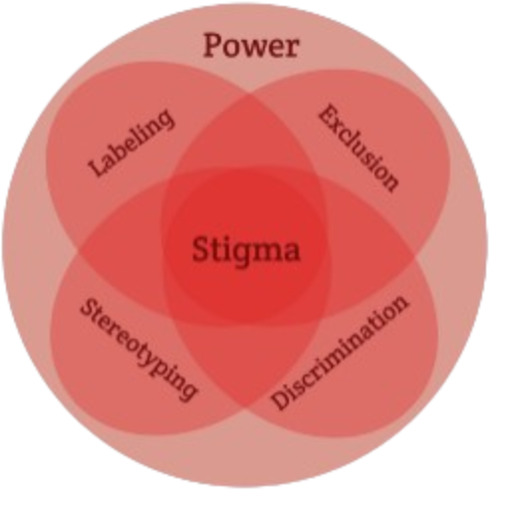
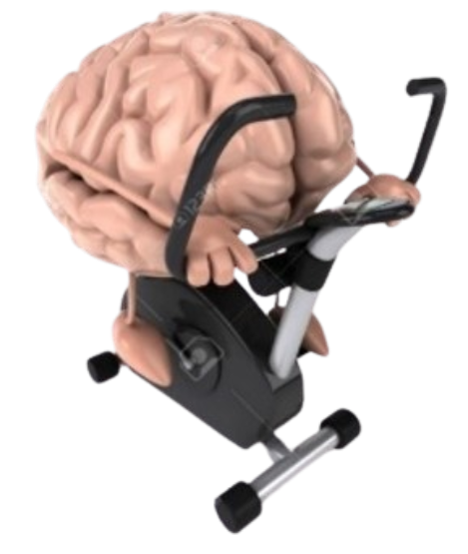


Exercise and Movement in People with Substance Use Disorders
Rural Opioid Technical Assistance Course
Pacific Southwest Region
Nora L. Nock, PhD, PE, FSBM
Professor
Department of Population & Quantitative Health Sciences
Case Western Reserve University
Notes:
Welcome to Module 4 of Exercise and Movement in people with substance use disorders

Slide 2
Module 4: Exercise in People with SUD: Special Considerations
Notes:
- People with a SUD may have a myriad of chronic health conditions that we need to be concerned with

Slide 3
Exercise in People with SUD:
Special Considerations
People with SUD have higher risk of comorbidities which can be improved with exercise including:
- hypertension (33% vs 21%; p<0.01)
- COPD (8.4% vs 2.7%; p<0.01)
[Bahorik et al. (2017) J Addict Med 11(1): 3-9]
Adults with SUD have lower cardiorespiratory fitness than those without SUD of same age & gender
Medications for OUD (MOUD) and psychotropic medications may increase weight gain and unhealthy food cravings (e.g., sweets)
Notes:
For example, people with a SUD are more likely to have hypertension & COPD or chronic obstructive pulmonary disease

Slide 4
Associations Between Chronic Amphetamine Misuse and Blood Pressure: Meta-Analysis
SBP:
1.93 (1.54-2.31)
DBP:
1.84 (1.51-2.16)
Chan M et al. (2025) Cochrane Database Syst Rev. 28;3(3):CD007896
Notes:
A recent meta analysis including 56 studies, found that chronic amphetamine use increased systolic blood pressure (SBP) by 1.93 mmHg [95% CI 1.54 to 2.31] and diastolic blood pressure (DBP) by 1.84 mmHg [95% CI 1.51 to 2.16] [56 studies, 10,583 participants; high‐certainty evidence for both]
Although these increases of about 2 mmHg may seem small, they are clinically significant [Zhang 2024]

Slide 5
Association Between Chronic Cocaine Use
and Pulmonary Hypertension
Pulmonary
Hypertension:
25% Cocaine Users
vs.
10% Non-Users
(p=0.01)
Alzghoul B et al. (2020) Am J Cardiol.125:282−288
Notes:
Chronic Cocaine users compared with non-cocaine users have been shown to have a significantly higher risk pulmonary hypertension [25% vs 10%, p = 0.012; [sPAP (mean ± standard deviation, 30.1 ± 13.1 vs 22.0 ± 9.8 mm Hg, p <0.001)]

Slide 6
Associations Between Chronic Methamphetamine Misuse and Cardiovascular Disease
ONeill E et al. (2025) Echocardiography, 42:e70180
Notes:
In a study that examined heart function in methamphetamine‐associated pulmonary hypertension (MA‐PAH) compared with idiopathic or non-METH associated hypertension (IPAH),
investigators found that patients with METH associated hypertension had more right atrium dilation, more right ventricle dilation and lower right ventricle systolic & diastolic function.
Suggesting that in addition to causing remodeling of the pulmonary vasculature, methamphetamines may have a direct cardiotoxic effect on the right heart.

Slide 7
Association Between Opioid Use and New Onset Atrial Fibrillation (AFib): Meta-Analysis
Menichelli D et al. (2025) Drug Safety (2025) 48:1079–1088
Notes:
Another meta analysis showed the use of opioids increases the risk of new-onset atrial fibrillation [hazard ratio 1.96, 95% confidence interval 1.43–2.69]
& Afib has been associated with an increased risk of stroke, myocardial infarction and heart failure

Slide 8
Associations Between Chronic Opioid Misuse and Cardiovascular Diseases: Meta-Analysis
Shofield J et al. (2025) European Journal of Preventive Cardiology (2025) 00:1–14
Notes:
And, Another recent meta-analysis found that chronic opioid misuse is associated with a 74% increase in risk of all cardiovascular diseases [summary effect: OR: 1.74, 95% CI: 1.12-2.70)]
With heart disease (OR: 1.51, 95% CI: 1.40-1.63) having the strongest association
[17 studies on a total of 1.7 million people. Most (9) looked at use of opium, 5 street drugs (heroin and fentanyl), and 5 prescription drugs]

Slide 9
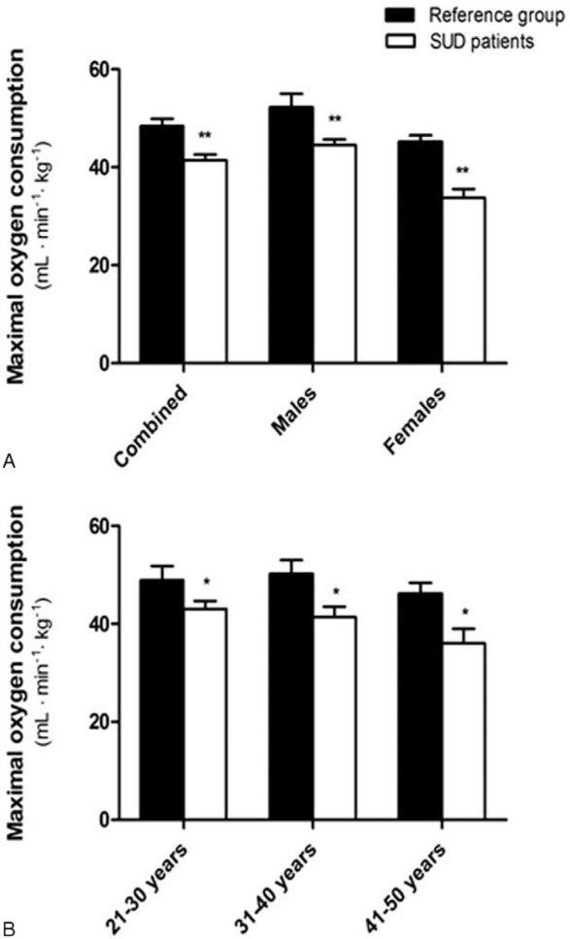
People with SUD have Lower Cardio-Respiratory Fitness vs. People without SUD
Mean fitness in men (44.6 ± 6.2 mL/kg•min) and women (33.8 ± 6.6 mL/kg•min) with SUD lower than normative (15% men; 25% women) [Flemmen et al. (2015) Medicine 94: e1914]
Mean fitness in men (38.4 ± 7.4 mL/kg•min) and women (30.8 ± 6.3 mL/kg•min) in the STRIDE trial at baseline was lower than normative values (40th (M) & 35th (F) %iles)
[Stoutenberg et al. (2017) J Subst Abuse Treat. 78: 74-79]
Mean Fitness (VO_{2max}) in Adults with SUD vs. Normative for Age-Gender
(Flemmen et al. (2015) Medicine 94: e1914)
Notes:
Thus, it is not surprising that people with a SUD have been shown to have lower fitness levels than norms for their age & gender [in people with out SUD]
And fitness may be even more reduced in women compared to men with a SUD

Slide 10
Medications for OUD: Methadone Maintenance
Therapy (MMT) Increases Cardiovascular Dysfunction
Mean Duration of MMT:
2.17 ± 1.34 years
Mean Dose of MMT:
52.10 ± 27.46 mg/day
Barkhordari H et al. (2025) J Res Pharm Pract 2025;14:59-65
Notes:
Medications for OUD help reduce opioid cravings and increase abstinence (National Academies of Science, Engineering, and Medicine, 2019).
Despite its proven efficacy in reducing opioid cravings and withdrawal symptoms, methadone has several side effects
In a study including 200 people with OUD under methadone maintenance therapy for an average of 2.2 years [mean dose of 52.1 ± 27.5 mg/day]
QT interval prolongation, which is a marker of potential ventricular arrhythmias and sudden cardiac arrest, was observed in 38% of participants.
13.5% and 8% exhibited mild and moderate left ventricular ejection fraction (LVEF), which is a measure of cardiac contractility
Significant correlations were observed between methadone dose and duration and these biomarkers of cardiac dysfunction suggesting dose and time dependent cardiotoxic effects of methadoneeffect
[Left ventricular end-diastolic diameter (LVEDD, an indicator of ventricular remodeling) was observed in 12.5% ]
[now clinical guidelines recommending baseline electrocardiograms (ECGs), regular monitoring, and evaluation for underlying cardiac risk factors]

Slide 11
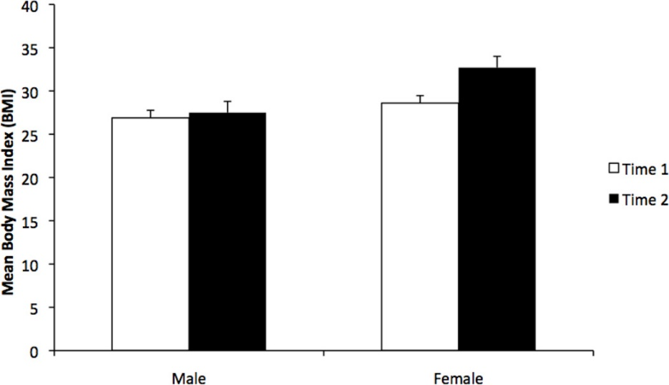
Medications for OUD (MOUD): Methadone Maintenance Therapy May Increase Weight
Mean BMI at Methadone start vs. at follow-up (1.8 ± 0.95 yrs) increased:
- 1.7 kg/m² (12 lbs; 6.4%) in males
- 5.2 kg/m² (28 lbs; 17.5%) in females
[Fenn et al., 2015 J Sub Abuse Treat. 51: 59-63]
Mean BMI with shorter follow up (0.74 +/- 0.46 yrs) increased with MMT (24.4 ± 4.3 vs. 22.5 ± 3.8 kg/m²)
but no significant differences by
gender reported
[Peles et al. (2016)
Subst Abus 37(4):613-618]
Mean Body Mass Index (BMI) Before (Time 1) and After (Time 2) Methadone Maintenance Treatment (MMT)
[Fenn et al. (2015) J Sub Abuse Treat. 51: 59-63]
Notes:
medications used to treat OUD such as Methadone may increase weight
& this weight gain may be substantially greater in women than in men
Weight gain and obesity can lead to an increase risk of cardiovascular disease, diabetes and stroke as well as certain cancers

Slide 12
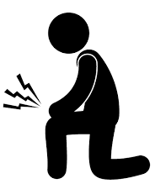
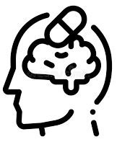
Current Landscape in Opioid Misuse,
Opioid Use Disorder and Chronic Pain
~ 10 Million Americans report misusing opioids annually
~ 6 Million Americans have an opioid use disorder (OUD)
~ 1 Million Americans report co-occurring mental illness
Drug overdose deaths involving an opioid continue to rise (75% of 107,622 deaths in 2021; 40% increase over 2019)
40-60% of people with OUD report having chronic pain
People with OUD and pain are 3-5x more likely to relapse
Notes:
About 1 Million of the 6 million Americans with an OUD report co-occurring mental illness

Slide 13
Interplay Between MOUD and
Mental Health Medications is Complex
~ 70-87% of people receiving MOUD have at least one co-occurring mental health disorder
~ 50% of people receiving MOUD are taking at least one psychiatric medication
Interactions between MOUD and psychotropic medications may exacerbate side effects and mental health challenges
Benzodiazepines are commonly prescribed to people receiving MOUD
Benzodiazepine prescriptions have been associated with a higher risk of non-overdose deaths [HR=2.02 (1.29-3.18)]
Stewart HLN et al. (2025) Journal of Drug Issues, 0(0)
Notes:
Many individuals who receive MOUD are also taking psychotropic medications (Morin et al., 2020; Peles et al., 2007; Samples et al., 2018).
About 70–87% of individuals receiving MOUD reported at least one co-occurring psychiatric diagnosis, and nearly half were taking at least one psychiatric medication (Morin et al., 2020; Peles et al., 2007; Samples et al., 2018).
Some people taking MOUD might experience side-effects that exacerbate their mental health challenges, such as anxiety (Elkader et al., 2009; Kampman & Jarvis, 2015; Lamont et al., 2020; Maremmani et al., 2019; Pedrelli et al., 2011; Zoorob et al., 2018).
benzodiazepines are commonly prescribed to MOUD patients
& Benzodiazepine prescriptions have been associated with a higher risk of non-overdose death (HR: 2.02, 95% CI: 1.29-3.18) [Abrahamsson T^{T} Drug Alcohol Depend 2017 May 1:174:58-64. ]
[Participants with psychotic disorders were more likely to be prescribed antidepressants (OR = 2.12, 95% CI = 1.06, 4.22, P = .033), antipsychotics (OR = 3.57, 95% CI = 1.74, 7.32, P = .001), mood stabilizers (OR = 6.61, 95% CI = 1.51, 28.97, P = .012), and benzodiazepines (OR = 2.22, 95% CI = 1.11, 4.43, P = .024).

Slide 14
Current Landscape in Opioid Misuse,
Opioid Use Disorder and Chronic Pain
~ 10 Million Americans report misusing opioids annually
~ 6 Million Americans have an opioid use disorder (OUD)
~ 1 Million Americans report co-occurring mental illness
Drug overdose deaths involving an opioid continue to rise (75% of 107,622 deaths in 2021; 40% increase over 2019)
40-60% of people with OUD report having chronic pain
People with OUD and pain are 3-5x more likely to relapse
Notes:
many people with a SUD also have pain
And about 40-60% of people with an OUD also report having chronic pain

Slide 15
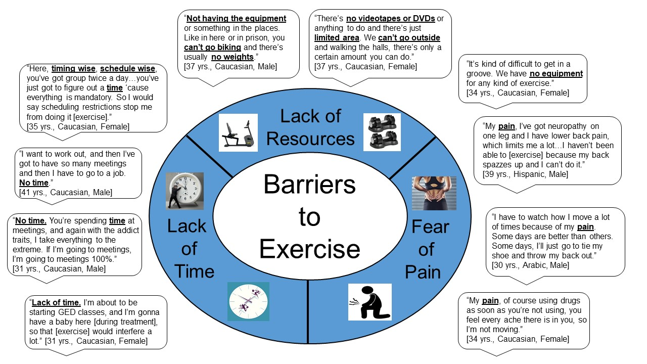
Interviews in Adults with OUD: Barriers to Exercise (n=33)
Nock et al. (2023) Barriers, Perceived Benefits and Preferences to
Exercise in Adults with OUD. Prev Med Rep. 29;36:102393
Notes:
In interviews with people with an OUD, we found that they viewed PAIN as both a barrier and a facilitator to exercise
Some patients reported having a fear of inducing or exacerbating their pain with exercise
They also reported other common barriers including lack of time & access to resources including equipment

Slide 16
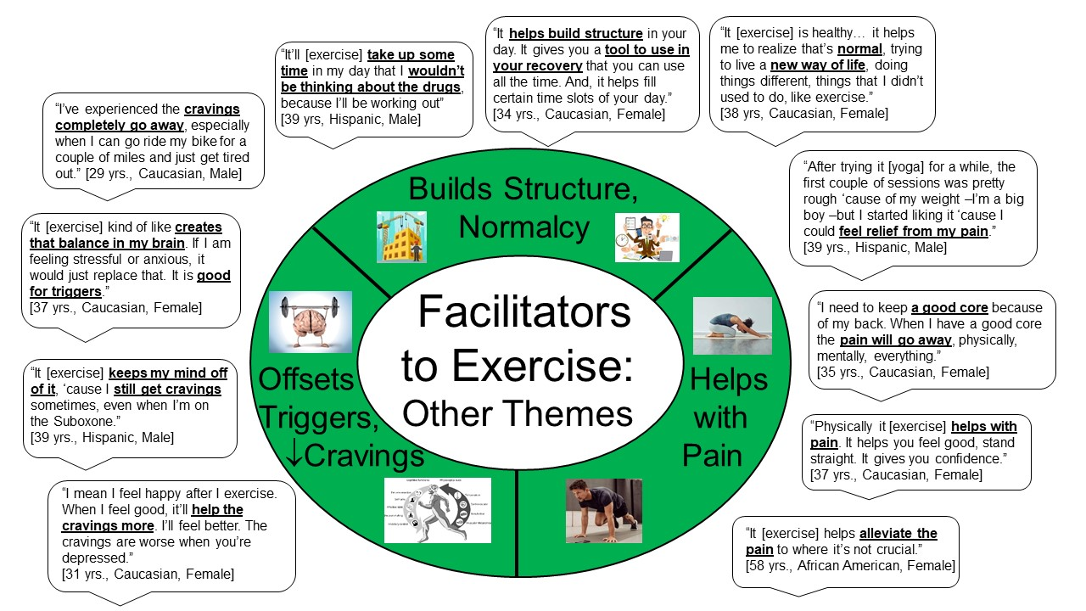
Interviews in Adults with OUD: Facilitators to Exercise (n=33)
Nock et al. (2023) Barriers, Perceived Benefits and Preferences to
Exercise in Adults with OUD. Prev Med Rep. 29;36:102393
Notes:
- On the other hand, many people with OUD talked about how they used exercise including cycling, stretching & yoga to help relieve their pain
- Several people also stated that exercise helped them to reduce their drug cravings & “build structure & normalcy”
-[?Other facilitators included social aspects & using exercise as a distraction to “keep their mind off drugs”]

Slide 17
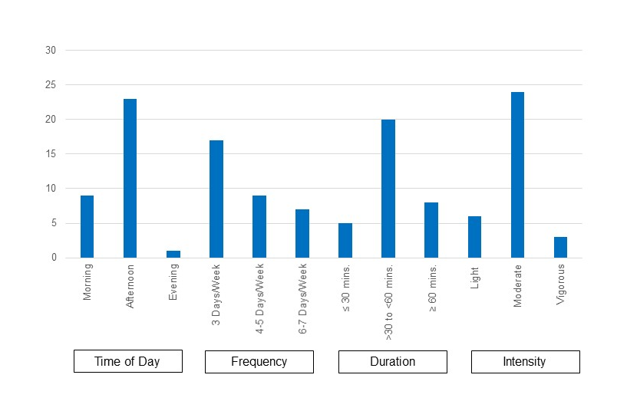
Interviews in Adults with OUD: Preferences to Exercise (n=33)
Most wanted exercise to be supervised by qualified professionals because of concerns about pain, low self-efficacy for exercise, anxiety and self-perceived “poor overall health” from misusing drugs
Most preferred moderate intensity, 3 days/week for 30-60 minute sessions
Nock et al. (2023) Barriers, Perceived Benefits and Preferences to
Exercise in Adults with OUD. Prev Med Rep. 29;36:102393
Notes:
because of their concerns about pain, anxiety, their low self-efficacy for exercise and self-perceived poor overall health from the damage they may have done to their bodies from using drugs, most people wanted to have exercise supervised by qualified exercise professionals
most also preferred a moderate intensity program [?offered 3 days per week with 30-60 minute sessions]

Slide 18
Currently No “Dose”, “FITT” Principle or Exercise “Prescription” for People with SUD
F (Frequency): ?? 3-5 sessions/week
I (Intensity): ?? 50-80% MHR, 50-60% HRR
T (Time/Duration): ?? 20-60 minutes/session
T (Type/Modality): ?? walking, cycling, running,
other activities
V (Volume): ???
P (Progression): ???
Notes:
- however, at this time, we do NOT know what the optimal “dose” or frequency, intensity, duration of exercise is to prescribe to people with SUD because we need more studies evaluated different “doses” and types of exercise
-

Slide 19
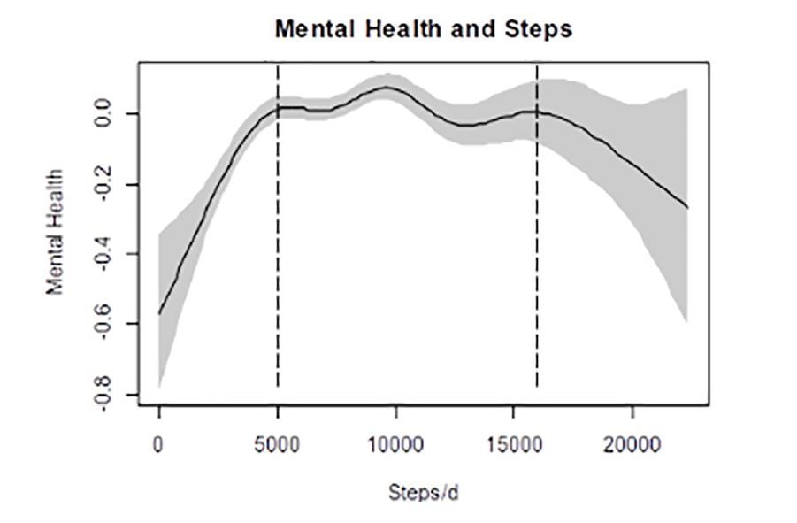
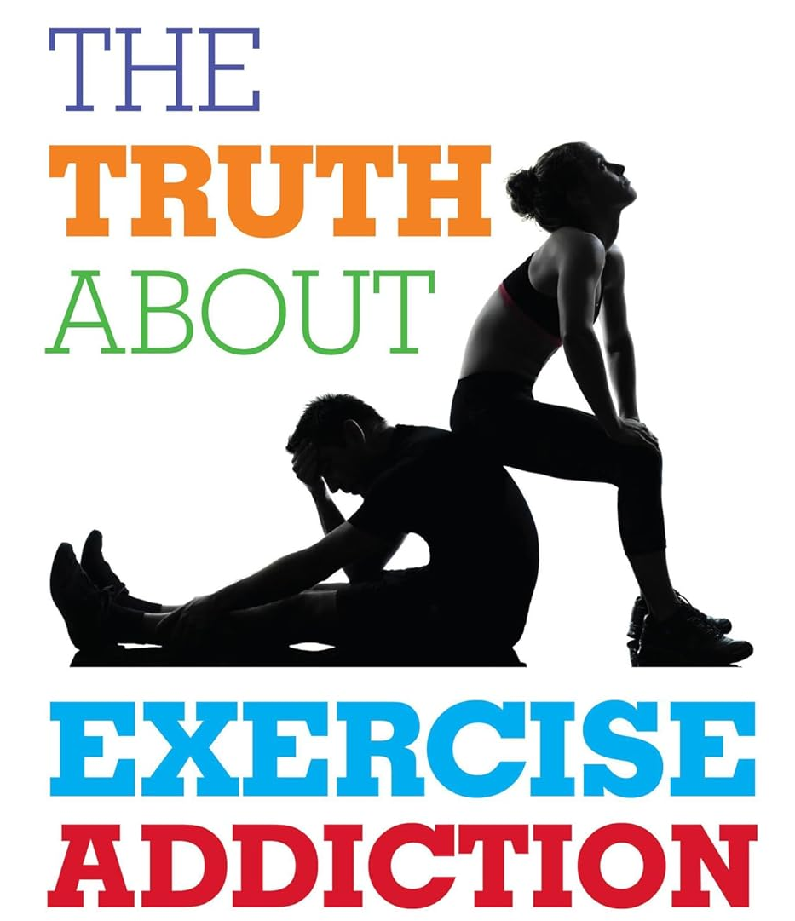
Exercise and Mental Health: The “Yin and Yang”
Bernard et al. (2018) Dose response association of objective physical activity with mental health in representative national sample of adults: A cross-sectional study. PLoS ONE 13(10): e0204682.
The Truth About Exercise Addiction:
Understanding the Dark Side of Thinspiration
Schreiber & Hausenblas (2015)
Notes:
However, As shown in this study on the left, there is a steep rise in self-reported mental health up to about 5000 steps per day
Which levels off around 10,000 steps per day
And then there is a pretty sharp decline after about 16,000 steps per day
suggesting that becoming active at low and moderate levels provides substantial improvement in mental health
but extreme levels of exercise or “over-exercising” may adversely effect mental health as well as lead to injuries & other illnesses
So we must be conscious of the potential for “addiction swapping” in people with a SUD due to co-occurring disorders,
This will be discussed in more detail in other sections of the course

