Slide 1

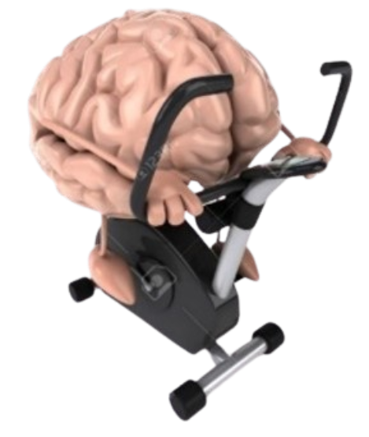


Exercise and Movement in People with Substance Use Disorders
Rural Opioid Technical Assistance Course
Pacific Southwest Region
Nora L. Nock, PhD, PE, FSBM
Professor
Department of Population & Quantitative Health Sciences
Case Western Reserve University
Notes:
Welcome to Module 2 of Exercise and Movement in people with substance use disorders

Slide 2
Module 2: Exercise and SUD: Rationale and Mechanisms
Notes:
- In this module, we will discuss the rationale and underlying mechanisms driving the benefits of exercise in people with SUD

Slide 3
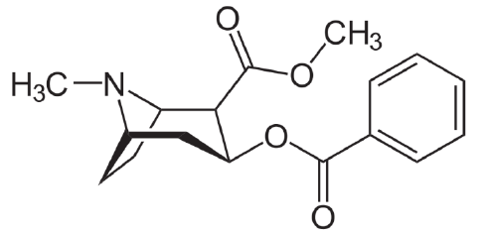
Chemical Structure of Dopamine and Stimulants: Amphetamines, Cocaine and MDMA
(“Speed”)
(“METH”)
Methylenedioxy-methamphetamine
Cocaine
(“Ecstasy”)
Annawald K et al. (2024) Herz 49:434–440; Kim ST & Park T (2019) Int. J. Mol. Sci.
20:584; Paz-Ramos (2023) Rev Invest Clin. 2023;75(3):143-57
Notes:
However, let’s first review how substances affect the body
Dopamine is an endogenous neurotransmitter that plays a role in many important bodily functions including movement & memory.
Dopamine also elicits pleasure and feelings of “reward”
The chemical structure of methamphetamine or “METH” is very similar to that of dopamine [and as you can see they both have a single benzene ring]
MDMA or “ecstasy” has a structure similar to Dopamine and Meth in that it also has a phenyl-ethyl-amine core, which is shown in blue
Cocaine has a significantly different chemical structure but still acts as a powerful stimulant of the central nervous system [Cocaine is a naturally derived tropane alkaloid, while amphetamine is a simpler, synthetic phenethylamine]
Due to the presence of two methyl groups, Meth is more lipophilic and has stronger addictive properties than other amphetamines such as “speed”
However, this increase in lipo-philicity allows Meth to more easily cross the blood–brain barrier and the placenta, which can lead to more toxic effects in the brain and to a mother’s offspring
[Chemical name METH: (2S)-N-methyl-1- phenylpropan-2-amine; AMPH: (2S)-1-phenylpropan-2-amine; MDMA: (2S)-1-(1,3-benzodioxol-5-yl)-N-methylpropan-2-amine ]

Slide 4
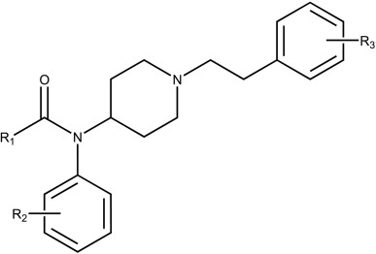
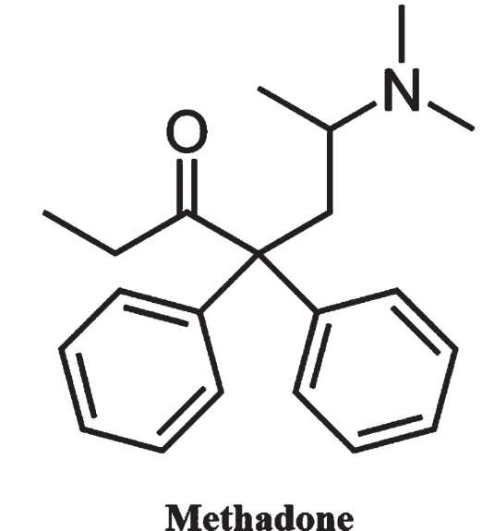
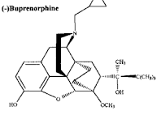
Chemical Structure of Opioids and
Medications to Treat Opioid Use Disorder (MOUD)
OPIOIDS:
Fentanyl
OPIOID
ANTOGONISTS:
(“Narcan”)
(“MOUD”)
Einstein TK (2022) Frontiers in Immunology. 10:2904; Varshneya NB et al. (2023)
Pharmacology, Biochemistry and Behavior 226:173572
Notes:
Heroin, fentanyl and morphine are “opioids” which are “analgesics” that provide pain relief
but they also have effects on other physiological systems including the neural system where they stimulate dopamine release
And, in the respiratory system, they reduce tidal volume and may lead to respiratory depression
Although Morphine is a natural product extracted from the opium poppy, heroin and fentanyl are synthetic and are substantially more potent [heroin is metabolized by deacetylation to morphine]
Naloxone (or Narcan), naltrexone, methadone and buprenorphine are antagonists of opioid receptors
Narcan is used to revive someone who overdosed on opioids with severe respiratory depression
Naltrexone, methadone & buprenorphine are Medications used to help treat people with an opioid use disorder or MOUD, which are FDA approved
[Methadone is a long-acting full μ-opioid receptor agonist, while buprenorphine is a partial agonist with a "ceiling effect," meaning its effects level off at higher doses, reducing the risk of overdose and dependency compared to full agonist]
[morphine is less lipophilic than heroin, making it easier to dissolve, and it is a Schedule 2 rather than a Schedule 1 drug, making it easier to obtain]

Slide 5
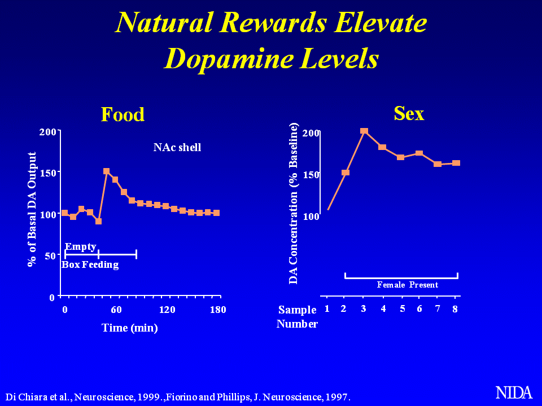
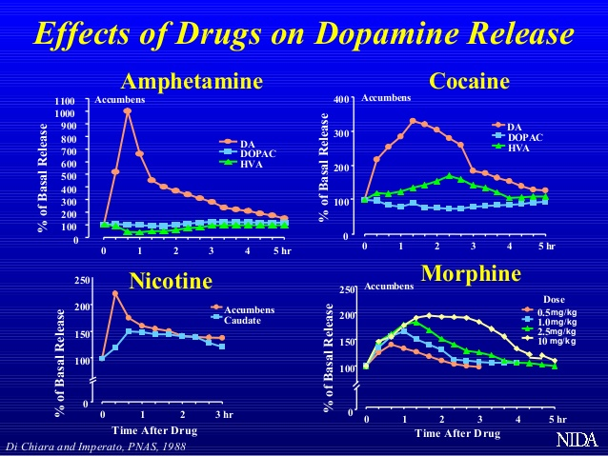
Dopamine (DA) Levels in the Brain Increase with Natural Rewards and Exogenous Substances
Lindsay A (2024) ACSM Annual Meeting
Notes:
As you see in the figure on the left, foods, particularly sweet and savory foods, can increase dopamine levels in the brain [+exercise; any Fig?]
However, the figure on the right, shows that the level of dopamine released with amphetamines is substantially greater than that with food or even other substances such as cocaine and morphine
This increase in dopamine and subsequent feeling of pleasure or reward drives the desire for people to want to get more and more of these substances
& This makes it very challenging for people to want to stop using substances after they become “addicted”

Slide 6
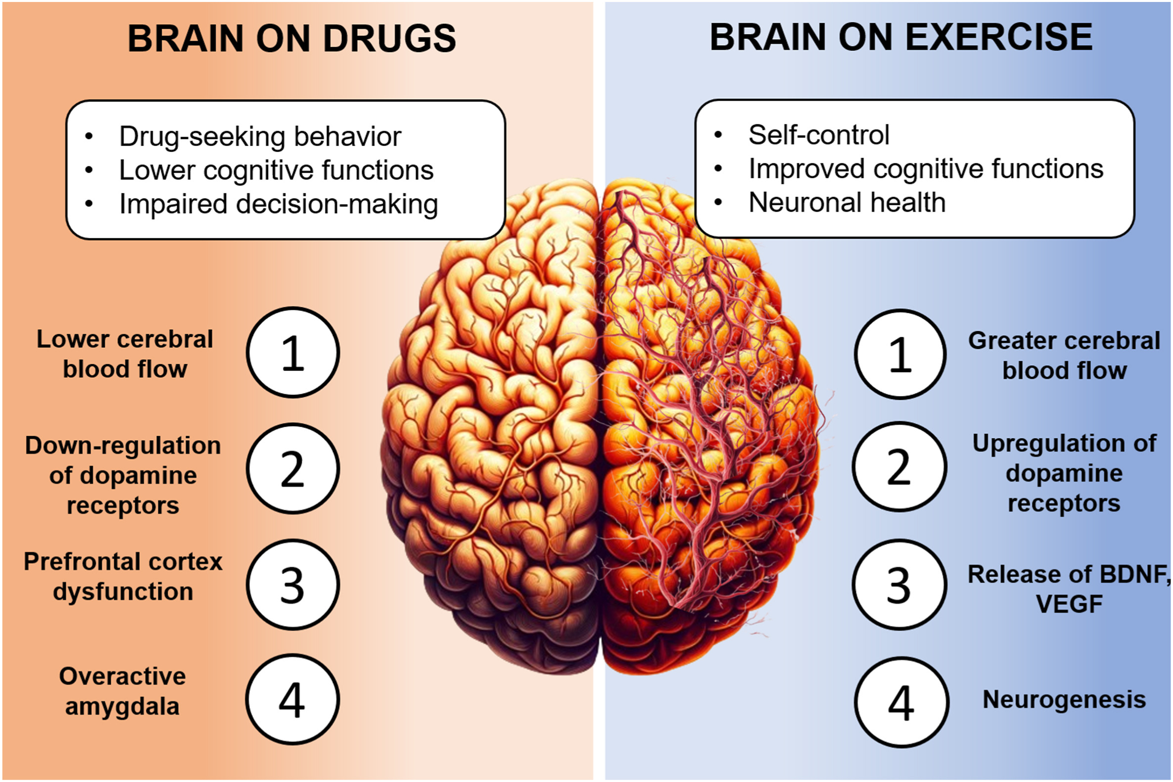
Brain “On Drugs” (Chronic Misuse) vs. “On Exercise”
Hypothesized that chronic misuse may dysregulate dopamine and “reward” and frontal (cognitive) brain regions
Cabral, D. A. et al. (2024) The role of physical exercise on the brain and cognitive functions of patients in recovery from substance use disorder: A narrative review and recommendations for researchers and practitioners. Mental Health and Physical Activity, 100594.
Notes:
However, an interesting phenomenon has been observed with chronic misuse of substances
Where chronic misuse or “addiction” seems to dampen the release of dopamine; and dysregulate the “reward” and frontal brain systems over time

Slide 7
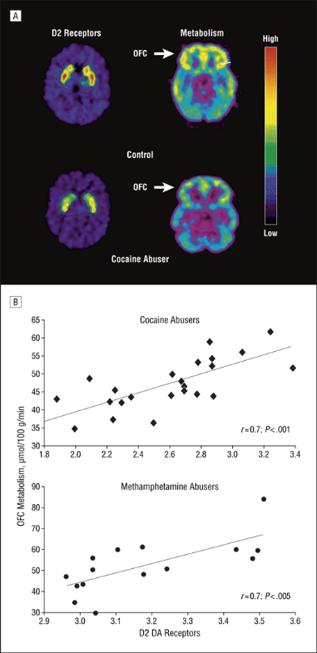
Chronic Stimulant Misuse Decreases Dopamine Receptor (D2) and Frontal Brain Activity
Volkow ND et al. (2007). Dopamine in Drug Abuse and Addiction: Results of Imaging Studies and Treatment Implications. Arch Neurol. 2007;64(11):1575-1579.
Notes:
In a seminal study [?led by Dr. Nora Volkow from National Institute on Drug Abuse or NIDA]
cocaine users were found to have less dopamine activity compared to “healthy” people or people without a SUD
They were also found to have less activity in the frontal parts of the brain, like the orbital frontal cortex or OFC, which help to “inhibit” or control impulsive behaviors, which could make recovery efforts more challenging

Slide 8
Neurobiology of Substance Misuse and “Addiction”
Nestler EJ (2005) The Neurobiology of Cocaine Addiction. Science and Practice Perspectives 4-10.
Notes:
Thus, stimulants that cause euphoria in the short term may lead to misuse or “addiction” in the long term via dysregulation to the brain’s limbic region which is located in the middle part of the brain affects pleasure and reward; [includes the ventral tegmental area (VTA) and nucleus accumbens (NAc)]
Chronic use also leads to dysregulation of the amygdala and hippocampus, which are the centers for emotions and memory, respectively,
In addition, there is often dysregulation to the frontal cortex, which effects cognition and restraint.
With opioids there is a similar dysregulation in that chronic exposure leads to “tolerance” to the analgesic effects and then a higher and/or more frequent “dose” is needed to get relief [or the psychotropic “numb” feelings ]

Slide 9
Physiological Effects of Methamphetamine on
Cardiovascular and Neurological Systems
Annawald K et al. (2024) Herz 49:434–440;
Notes:
stimulants including methamphetamines induce arterial vasospasms potentially leading to hypertension
- and may trigger a variety of cardiac symptoms including arrhythmias, myocardial infarction, heart failure, and stroke
- long-term meth use often leads to severe systolic dysfunction and dilation of the left ventricle
- methamphetamine has also been shown to impair memory, executive function and other cognitive functions and
has been associated with higher levels of anxiety and depression
-[Electrocardiograms of meth users often show ST-segment elevation due to myocardial infarction, long QT syndrome, atrial fibrillation, ventricular tachycardia; however, methamphetamine-related cardiomyopathy may be reversible with abstinence and potentially exercise?]
- [Meth promotes the formation of atherosclerotic plaques through endothelial activation and cytokine-driven inflammation]

Slide 10
Cocaine Effects on Cardiovascular and CNS Systems
Bachi K et al. (2017) Atherosclerosis 262: 154e162
Notes:
Cocaine also affects the cardiovascular system and the central nervous system (CNS)
At lower doses, Cocaine increases heart rate and blood pressure
And, At high doses, cocaine can cause cardiac arrest and chronic misuse may lead to a higher risk of stroke

Slide 11
Acute and Chronic Effects of Substances
on the Cardiovascular System
Tobolski J et al. (2022) Heart Failure Reviews. 27:2059–2065
Notes:
Misuse of other substances such as alcohol and opiates can also increase the risk of cardiomyopathy, heart failure and cardiac arrest

Slide 12
Prenatal Stimulant Exposure and Adult CVD Risk
Rorabaugh B (2021) Frontiers in Cardiovascular Medicine: 8: 652634
Notes:
Exposure to stimulants such as cocaine & methamphetamines during the gestational period can negatively impact the heart and vasculature, potentially leading to cardiovascular diseases later in life.
Preclinical or studies in animals have shown that prenatal exposure to methamphetamines and cocaine can lead to glucose intolerance, diabetes, obesity, alterations in lipid metabolism, vascular dysfunction and increased susceptibility to cardiac ischemic injury in the offspring as adults

Slide 13
Brain “On Drugs” vs. Brain “On Exercise”
Hypothesized that exercise may help upregulate dopamine, reward and frontal (cognitive) brain regions
Cabral DA et al.(2024) The role of physical exercise on the brain and cognitive functions of patients in recovery from substance use disorder: A narrative review and recommendations for researchers and practitioners. Mental Health and Physical Activity, 100594.
Notes:
Exercise is often viewed as a “natural reward” because it has also been shown to increase dopamine levels
And Exercise has been shown to increase activity in the several brain regions including the reward center and frontal brain regions

Slide 14
Exercise May Induce Structural and Functional Plasticity in the Hippocampus
Exercise, particularly at higher intensities, may enhance neurogenesis, increase hippocampal volume, and promote angiogenesis
This may increase central and peripheral growth and neurotrophic factors (e.g., VEGF and BDNF) which may help enhance learning and memory
Cooper et al. (2018) Cold Spring Harb Perspect Med. 8(4): a029736
Notes:
In particular, Exercise at higher intensities, has been shown to increase angiogenesis or the blood flow and vasculature in the brain
Which can in turn promote neurogenesis or the development of new brain cells
Exercise has also been shown to increase the volume of certain parts of the brain like the hippocampus
That can help enhance learning & memory

Slide 15
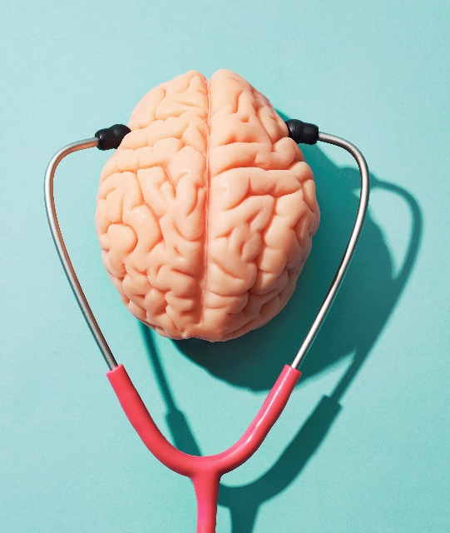
Exercise May Improve Learning, Memory, Executive Function and Other Brain Processes
    Learning
    Memory
    Attention
    Executive Function:
      ability to start a task
      ability to plan and organize
      self-regulate behavior, control emotions
U.S. Department of Health and Human Services. (2018) Physical Activity Guidelines for Americans, 2nd edition. Washington, DC. Department of Health and Human Services
Notes:
Exercise may also help improve frontal brain regions processes such as executive function
That help people to improve self-regulation and control of their emotions
Which are important skills that need to be refined to be successful in recovery

Slide 16
Exercise May Be Most Efficacious in SUD as an Adjunctive Treatment During Early Abstinence
Nock et al. (2017) Neurobiology of substance use in adolescents and potential therapeutic effects of exercise for prevention and treatment of substance use disorders. Birth Defects Res. 09(20):1711-1729
Notes:
animal model studies suggest that intervening with exercise during early abstinence may provide the best improvements in relapse rates
So exercise may be best when integrated into drug treatment programs during early recovery
to help “prime” the brain and help potentially repair structural and functional brain deficits induced by substance misuse

