Slide 1
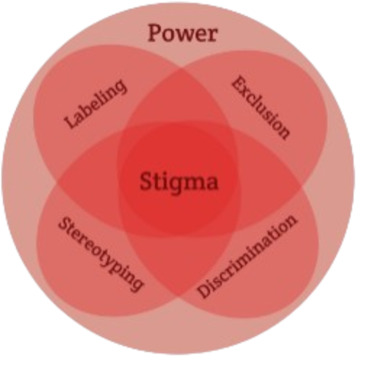
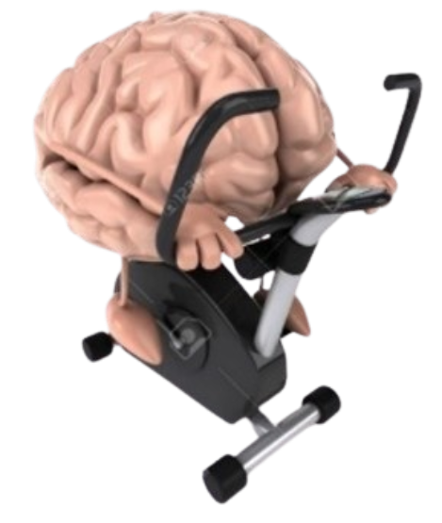


Exercise and Movement in People with Substance Use Disorders
Rural Opioid Technical Assistance Course
Pacific Southwest Region
Nora L. Nock, PhD, PE, FSBM
Professor
Department of Population & Quantitative Health Sciences
Case Western Reserve University
Notes:
-Welcome to Exercise and Movement in people with substance use disorders

Slide 2
Module 4: Exercise in People with SUD: Special Considerations
Notes:
- And people with a SUD may have a myriad of chronic health conditions that we need to be concerned with

Slide 3
Exercise in People with SUD:
Special Considerations
People with SUD have higher risk of comorbidities which can be improved with exercise including:
- hypertension (33% vs 21%; p<0.01)
- COPD (8.4% vs 2.7%; p<0.01)
[Bahorik et al. (2017) J Addict Med 11(1): 3-9]
Adults with SUD have lower cardiorespiratory fitness than those without SUD of same age & gender
Medications for OUD (MOUD) and psychotropic medications may increase weight gain and unhealthy food cravings (e.g., sweets)
Notes:
-People with a SUD are more likely to have hypertension & COPD or chronic obstructive pulmonary disease

Slide 4
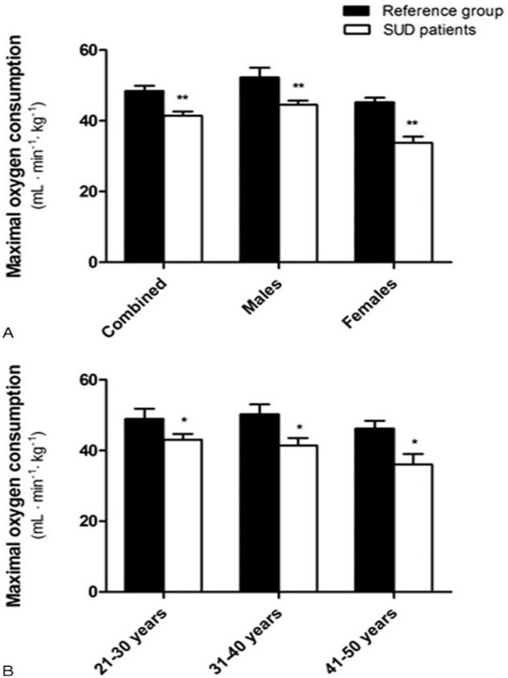
People with SUD have Lower Cardio-Respiratory Fitness vs. People without SUD
Mean fitness in men (44.6 ± 6.2 mL/kg•min) and women (33.8 ± 6.6 mL/kg•min) with SUD lower than normative (15% men; 25% women) [Flemmen et al. (2015) Medicine 94: e1914]
Mean fitness in men (38.4 ± 7.4 mL/kg•min) and women (30.8 ± 6.3 mL/kg•min) in the STRIDE trial at baseline was lower than normative values (40th (M) & 35th (F) %iles)
[Stoutenberg et al. (2017) J Subst Abuse Treat. 78: 74-79]
Mean Fitness (VO_{2max}) in Adults with SUD vs. Normative for Age-Gender
(Flemmen et al. (2015) Medicine 94: e1914)
Notes:
People with a SUD have also been shown to have lower fitness levels than norms for their age & gender [in people with out SUD]
And fitness may be even more reduced in women compared to men with a SUD

Slide 5
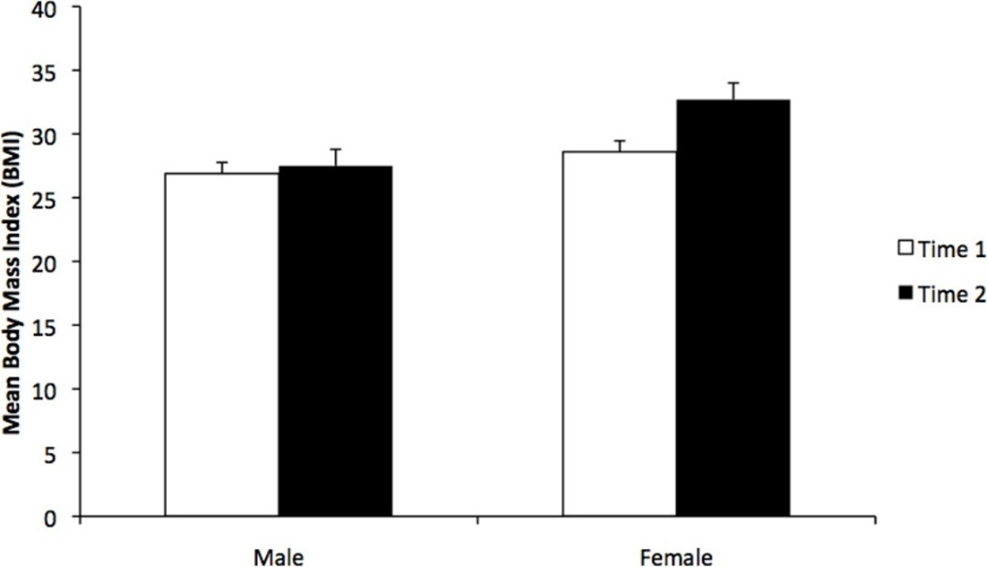
Medications for OUD (MOUD) and Mental Health Disorders May Increase Weight
Mean BMI at Methadone start vs. at follow-up (1.8 ± 0.95 yrs) increased:
- 1.7 kg/m² (12 lbs; 6.4%) in males
- 5.2 kg/m² (28 lbs; 17.5%) in females
[Fenn et al., 2015 J Sub Abuse Treat. 51: 59-63]
Mean BMI with shorter follow up (0.74 +/- 0.46 yrs) increased with MMT (24.4 ± 4.3 vs. 22.5 ± 3.8 kg/m²) but no significant differences by gender reported.
[Peles et al. (2016) Subst Abus 37(4):613-618]
Mean Body Mass Index (BMI) Before (Time 1) and After (Time 2) Methadone Maintenance Treatment (MMT)
[Fenn et al. (2015) J Sub Abuse Treat. 51: 59-63]
Notes:
medications used to treat OUD such as Methadone may increase weight
& this weight gain may be substantially greater in women than in men
Weight gain and obesity can lead to an increase risk of cardiovascular disease, diabetes and stroke as well as certain cancers

Slide 6
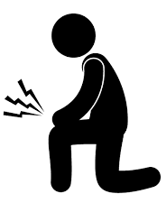

Current Landscape in Opioid Misuse, Opioid Use Disorder and Chronic Pain
~ 10 Million Americans report misusing opioids annually
~ 6 Million Americans have an opioid use disorder (OUD)
~ 1 Million Americans report co-occurring mental illness
Drug overdose deaths involving an opioid continue to rise (75% of 107,622 deaths in 2021; 40% increase over 2019)
40-60% of people with OUD report having chronic pain
People with OUD and pain are 3-5x more likely to relapse
Notes:
many people with a SUD also have pain
And about 40-60% of people with an OUD also report chronic pain

Slide 7
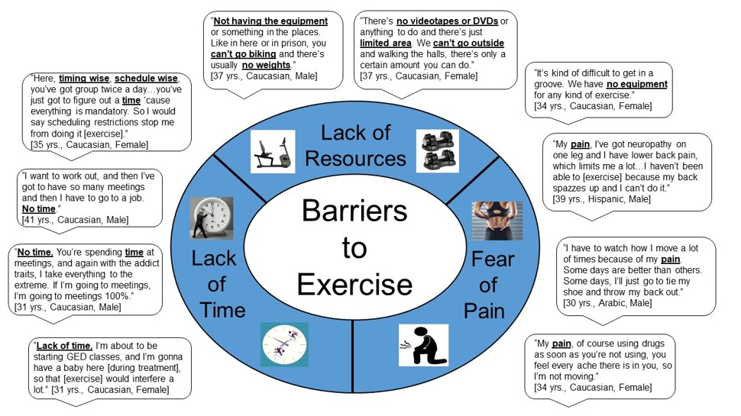
Interviews in Adults with OUD: Barriers to Exercise (n=33)
Nock et al. (2023) Barriers, Perceived Benefits and Preferences to Exercise in Adults with OUD. Prev Med Rep. 29;36:102393
Notes:
In interviews with people with an OUD, we found that they viewed PAIN as both a barrier and a facilitator to exercise
Some patients reported having a fear of inducing or exacerbating their pain with exercise
They also reported other common barriers including lack of time & access to resources including equipment

Slide 8
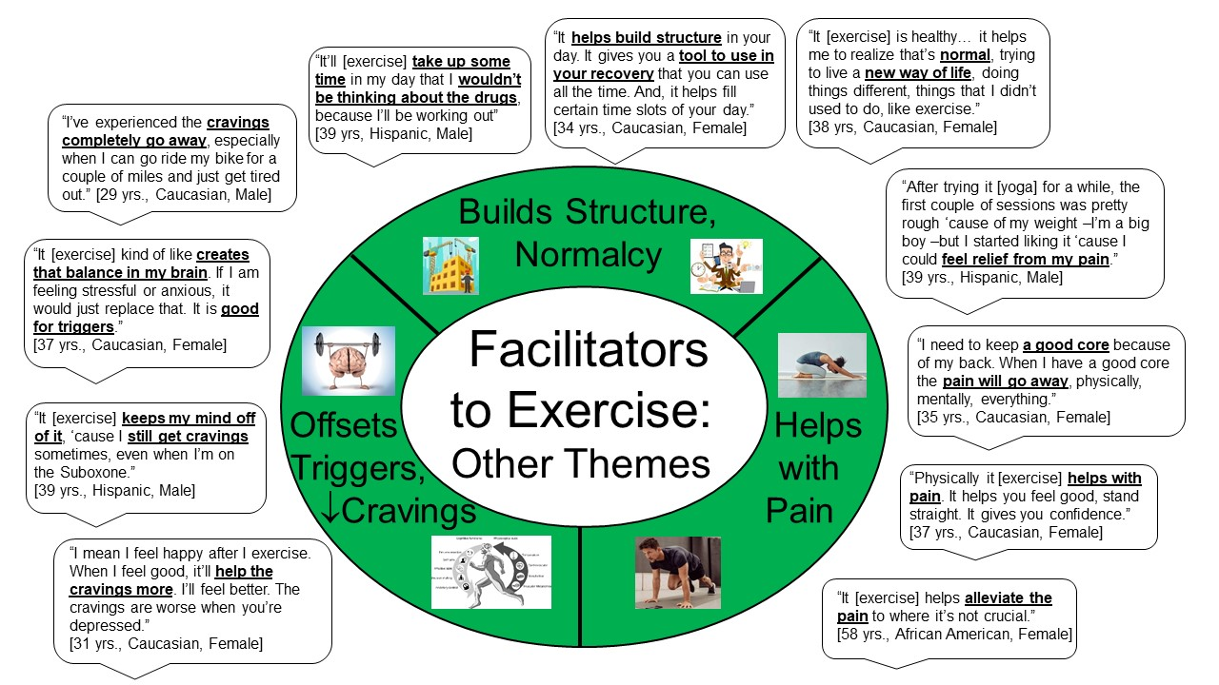
Interviews in Adults with OUD: Facilitators to Exercise (n=33)
Nock et al. (2023) Barriers, Perceived Benefits and Preferences to Exercise in Adults with OUD. Prev Med Rep. 29;36:102393
Notes:
- On the other hand, many people with OUD talked about how they used exercise including cycling, stretching & yoga to help relieve their pain
- Several people also stated that exercise helped them to reduce their drug cravings & “build structure & normalcy”
-[Other facilitators included social aspects & using exercise as a distraction to “keep their mind off drugs”]

Slide 9
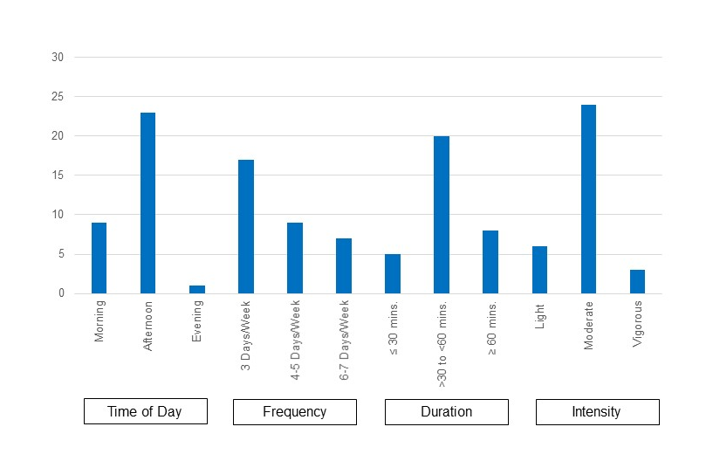
Interviews in Adults with OUD: Preferences to Exercise (n=33)
Most wanted exercise to be supervised by qualified professionals because of concerns about pain, low self-efficacy for exercise, anxiety and self-perceived “poor overall health” from misusing drugs
Most preferred moderate intensity, 3 days/week for 30-60 minute sessions
Nock et al. (2023) Barriers, Perceived Benefits and Preferences to Exercise in Adults with OUD. Prev Med Rep. 29;36:102393
Notes:
because of their concerns about pain, anxiety, their low self-efficacy for exercise and self-perceived poor overall health from the damage they may have done to their bodies from using drugs, most people wanted to have exercise supervised by qualified exercise professionals
most also preferred a moderate intensity program [?offered 3 days per week with 30-60 minute sessions]

Slide 10
No Exercise “Dose” Standards
Currently No “Dose”, “FITT” Principle or Exercise “Prescription” for People with SUD
F (Frequency): ?? 3-5 sessions/week
I (Intensity): ?? 50-80% MHR, 50-60% HRR
T (Time/Duration): ?? 20-60 minutes/session
T (Type/Modality): ?? walking, cycling, running,
other activities
V (Volume): ???
P (Progression): ???
Notes:
- however, at this time, we do NOT know what the optimal “dose” or frequency, intensity, duration of exercise is to prescribe to people with SUD because we need more studies evaluated different “doses” and types of exercise
-

Slide 11
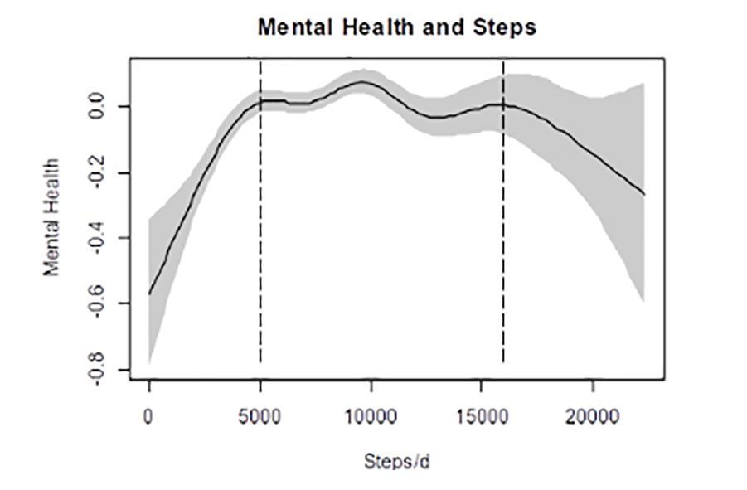
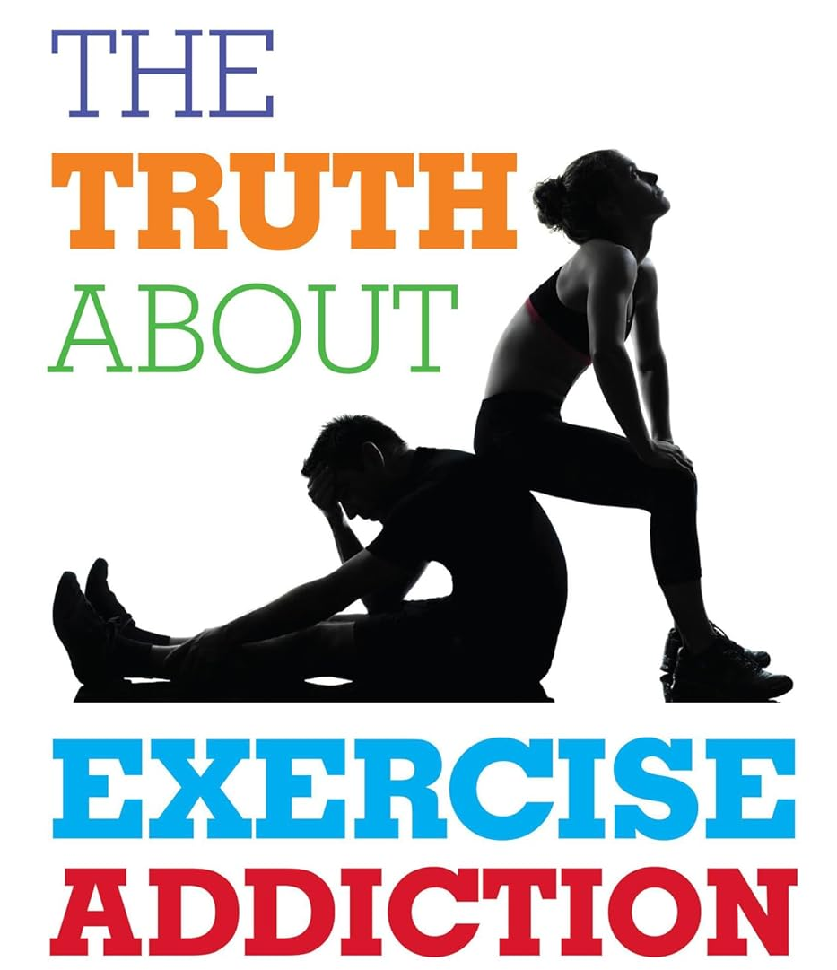
Exercise and Mental Health: The “Yin and Yang”
Bernard et al. (2018) Dose response association of objective physical activity with mental health in representative national sample of adults: A cross-sectional study. PLoS ONE 13(10): e0204682.
The Truth About Exercise Addiction:
Understanding the Dark Side of Thinspiration
Schreiber & Hausenblas (2015)
Notes:
However, As shown in this study on the left, there is a steep rise in self-reported mental health up to about 5000 steps per day
Which levels off around 10,000 steps per day
And then there is a pretty sharp decline after about 16,000 steps per day
suggesting that becoming active at low and moderate levels provides substantial improvement in mental health
but extreme levels of exercise or “over-exercising” may adversely effect mental health as well as lead to injuries & other illnesses
So we must be conscious of the potential for “addiction swapping” in people with a SUD due to co-occurring disorders,
This will be discussed in more detail in other sections of the course

