Slide 1

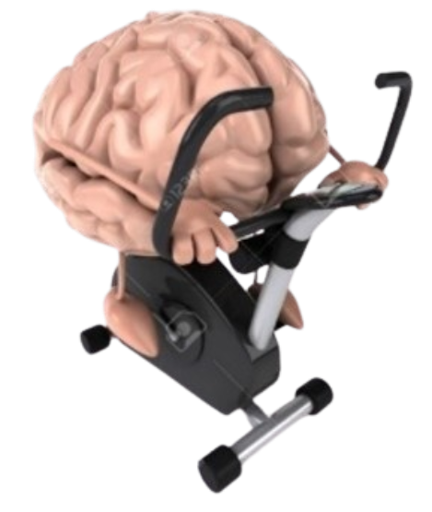


Exercise and Movement in People with Substance Use Disorders
Rural Opioid Technical Assistance Course
Pacific Southwest Region
Nora L. Nock, PhD, PE, FSBM
Professor
Department of Population & Quantitative Health Sciences
Case Western Reserve University
Notes:
-Welcome to Exercise and Movement in people with substance use disorders

Slide 2
Module 2: Exercise and SUD: Rationale and Mechanisms
Notes:
In this module, we will discuss some of the benefits of exercise in people with SUD

Slide 3
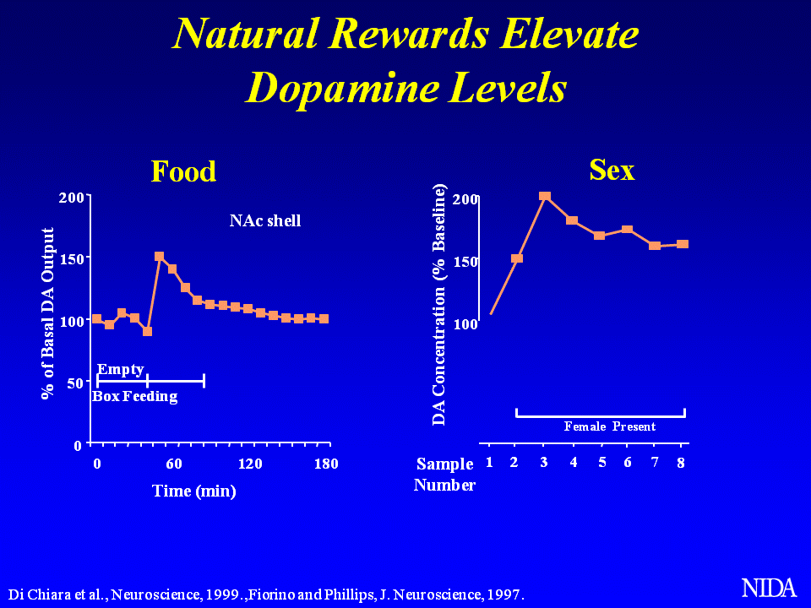
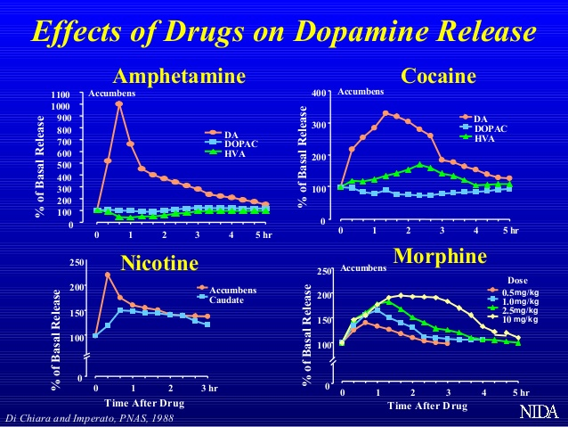
Dopamine (DA) Levels in the Brain Increase with Natural Rewards and Exogenous Substances
Lindsay A (2024) ACSM Annual Meeting
Notes:
However, let’s first discuss how substances can affect the brain
Dopamine is a neurotransmitter that plays a role in many important functions such as movement & memory as well as pleasure or “reward”
Foods, particularly sweet and savory foods, increase dopamine levels in the brain
Dopamine also increases when using substances such as cocaine, nicotine and amphetamines
As you can see in the figure on the right, the level of dopamine released with amphetamines is substantially greater than that with food or with other substances such as cocaine and morphine
And this increase in dopamine & the subsequent feeling of “reward”, whether its from natural substances like food or from synthetic chemicals like methamphetamine,
Drives the desire for people to want to get more of these substances to get more pleasure & reward
This makes it very challenging for people to want to stop using substances after they become “addicted”

Slide 4
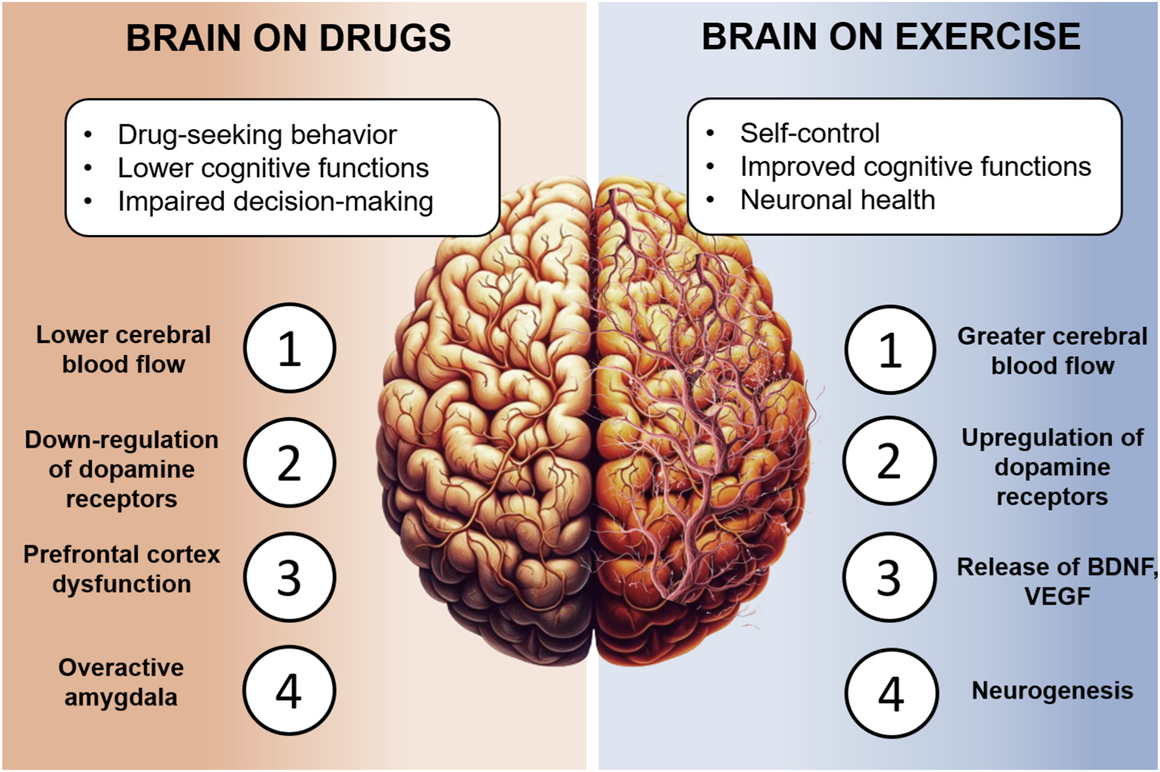
Brain “On Drugs” (Chronic Misuse) vs. “On Exercise”
Hypothesized that chronic misuse may dysregulate dopamine and “reward” and frontal (cognitive) brain regions
Cabral, D. A. et al. (2024) The role of physical exercise on the brain and cognitive functions of patients in recovery from substance use disorder:
A narrative review and recommendations for researchers and practitioners. Mental Health and Physical Activity, 100594.
Notes:
However, an interesting phenomenon has been observed with chronic misuse of substances
Where chronic misuse or “addiction” seems to dampen the release of dopamine
and dysregulate the “reward” and frontal brain systems over time

Slide 5
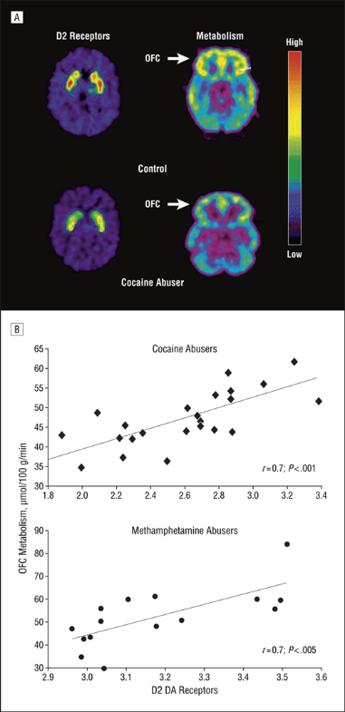
Chronic Stimulant Misuse Decreases Dopamine Receptor (D2) and Frontal Brain Activity
Volkow ND et al. (2007). Dopamine in Drug Abuse and Addiction:
Results of Imaging Studies and Treatment Implications. Arch
Neurol. 2007;64(11):1575-1579.
Notes:
In a seminal study [?led by Dr. Nora Volkow from National Institute on Drug Abuse or NIDA]
cocaine users were found to have less dopamine activity compared to “healthy” people or people without a SUD
They were also found to have less activity in the frontal parts of the brain, which help to “inhibit” or control impulsive behaviors

Slide 6
Brain “On Drugs” vs. Brain “On Exercise”
Hypothesized that exercise may help upregulate dopamine, reward and frontal (cognitive) brain regions
Cabral DA et al.(2024) The role of physical exercise on the brain and cognitive functions of patients in recovery from substance use disorder: A narrative review and recommendations for researchers and practitioners. Mental Health and Physical Activity, 100594.
Notes:
Exercise is often viewed as a “natural reward” because it has also been shown to increase dopamine levels
And increase activity in the reward center and frontal brain regions

Slide 7
Exercise May Induce Structural and Functional Plasticity in the Hippocampus
Exercise, particularly at higher intensities, may enhance neurogenesis, increase hippocampal volume, and promote angiogenesis
This may increase central and peripheral growth and neurotrophic factors (e.g., VEGF and BDNF) which may help enhance learning and memory
Cooper et al. (2018) Cold Spring Harb Perspect Med. 8(4): a029736
Notes:
In particular, Exercise at higher intensities, has been shown to increase angiogenesis or the blood flow and vasculature in the brain
Which can in turn promote neurogenesis or the development of new brain cells
Exercise has also been shown to increase the volume of certain parts of the brain like the hippocampus
That can help enhance learning & memory

Slide 8
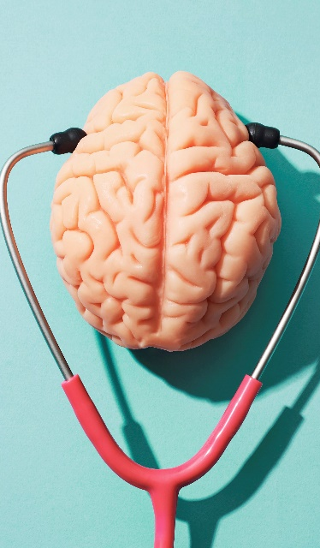
Exercise May Improve Learning, Memory, Executive Function and Other Brain Processes
    Learning
    Memory
    Attention
    Executive Function:
      ability to start a task
      ability to plan and organize
      self-regulate behavior, control emotions
U.S. Department of Health and Human Services. (2018) Physical Activity Guidelines for Americans, 2nd edition. Washington, DC. Department of Health and Human Services
Notes:
Exercise may also help improve frontal brain regions processes such as executive function
That help people to improve self-regulation and control of their emotions
These are important skills that need to be refined to be successful in recovery

Slide 9
Exercise May Be Most Efficacious in SUD as an Adjunctive Treatment During Early Abstinence
Nock et al. (2017) Neurobiology of substance use in adolescents and potential therapeutic effects of exercise for prevention and treatment of substance use disorders. Birth Defects Res. 09(20):1711-1729
Notes:
animal model studies suggest that intervening with exercise during early abstinence may provide the best improvements in relapse rates
So exercise may be best when integrated into drug treatment programs during early recovery
to help “prime” the brain and help potentially repair structural and functional brain deficits induced by substance misuse

