Slide 1
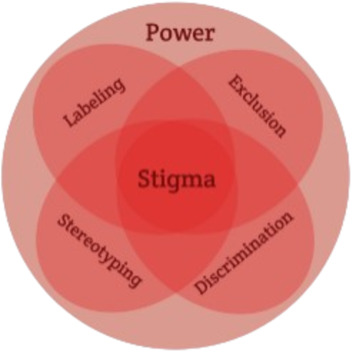
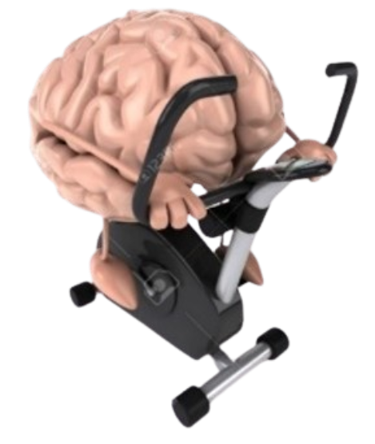


Exercise and Movement in People with Substance Use Disorders
Rural Opioid Technical Assistance Course
Pacific Southwest Region
Nora L. Nock, PhD, PE, FSBM
Professor
Department of Population & Quantitative Health Sciences
Case Western Reserve University
Notes:
-Welcome to Exercise and Movement in people with substance use disorders

Slide 2
Exercise and Movement in People with Substance Use Disorders (SUD): Outline
Module 1: Current Evidence
Module 2: Rationale & Mechanisms
Module 3: Current Exercise “Prescriptions”
Module 4: Special Considerations for People with SUD
Module 5: ACSM “Call to Action” and Summary
Notes:
We will start with the current evidence for promoting exercise in people with a substance use disorder
Then discuss the underlying mechanisms
And cover Exercise Prescriptions and
Special Considerations needed for people with substance use disorders
Then we will discuss a recent “Call to Action” and provide a “take home” summary of key aspects covered

Slide 3
Module 1: Exercise and SUD: Current Evidence
Notes:
First, we will look at the evidence with substance use disorders collectively
and then examine evidence with some specific types of substances including alcohol and methamphetamines

Slide 4
Systematic Review:
- seeks to collate empirical evidence to address a specific research question
Meta Analysis:
- uses statistical methods to quantify a “summary effect” estimate (SE) and its corresponding confidence intervals (CIs)
- how similar results are across studies (SE) and how robust and precise the summary effect is (CIs)
Summarizing Evidence:
Systematic Reviews vs. Meta Analyses
Notes:
I will present evidence from systematic reviews and “meta analyses”
For those that might not be familiar, a meta analysis is different than a systematic review in that a meta analysis uses statistical methods to summarize the collective evidence and calculates a “summary effect” estimate
The summary effect estimate basically tells us how robust and similar results are across studies and the confidence intervals tell us how precise this estimate is

Slide 5
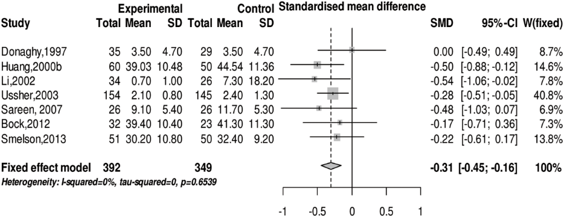
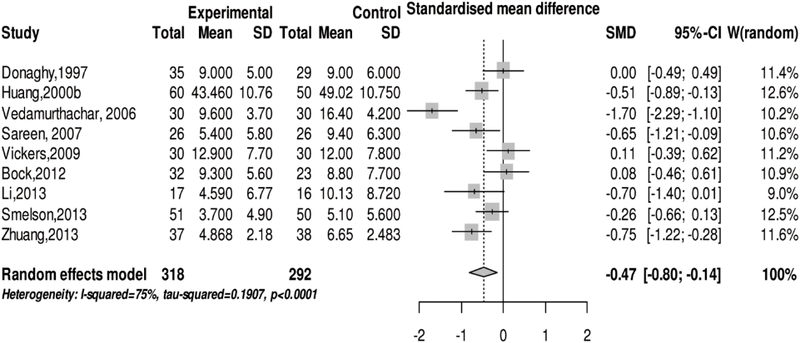
Exercise Increases Abstinence and Decreases Anxiety and Depression in People with SUD
Anxiety
Abstinence
Depression
Wang D et al. (2014): PLoS ONE 9(10): e110728
Notes:
An important product of a meta analysis is the “forest plot”
An example of the forest plot is shown on the left panel
You can see each individual study’s author & year is followed by information on the study sample size
Then, the results from each study are shown on a horizontal line followed by the actual individual effect estimates and CIs
The “W” is the weight each study has in the overall “summary effect estimate”
And the “summary effect estimate“ in shown in bold text at the bottom on the right hand side of the figure
- in this case, the Summary Effect Estimate is 1.69 and the confidence intervals are 1.44 and 1.99
this summary effect is considered “statistically significant” because the Confidence Intervals do NOT cross the solid vertical line, which represents the null hypothesis
So, in summary, we can conclude from this meta analysis that Exercise compared to not exercising INCREASES drug Abstinence by 69%
In the figures on the right hand side, we see that the Summary Effect Estimate & the Confidence Intervals are to the left of the vertical line
Here, we conclude that Exercise DECREASES Anxiety in people with SUD by 31%
And exercise DECREASES Depression in people with SUD by 47%
All of these results are “statistically significant” because the CIs for the Summary Effect Estimate do not cross the vertical line

Slide 6
Exercise Improves Cognition, Anxiety and Depression Scores in People with SUD
Anxiety
Cognitive Levels
Depression
Zheng et al. (2024) Effect of physical exercise on emotional & cognitive levels of patients with SUD: a meta-analysis. Front Psychol. 15:1348224
Notes:
Here is another meta analysis published earlier this year that shows that exercise helps to improve cognitive levels in people with SUD [by 52%]
and confirms previous evidence that exercise decreases anxiety & depression in people with SUD [by 73% and 67%, respectively]
And all of these results are “statistically significant” because the confidence intervals do not cross the vertical line

Slide 7
Exercise Improves Social, Emotional and Functional Domains of QoL in People with SUD
Social Quality of Life (QoL)
Physical Function QoL
Emotional QoL
Bodily Pain
Giménez-Meseguer et al. (2020) The Benefits of Physical Exercise on Mental Disorders and Quality of Life in Substance Use Disorders Patients.
Systematic Review and Meta-Analysis. Int. J. Environ. Res. Public Health. 17: 3680
Notes:
This is another meta analysis that shows exercise improves social and emotional domains of quality of life
And that exercise improves physical function and pain in people with SUD

Slide 8
Exercise Decreases Drinking Volume and Increases Fitness in Alcohol Use Disorders
Drinking Volume
Fitness
Lardier et al. (2021) Exercise as a Useful Intervention to Reduce Alcohol Consumption and Improve Physical Fitness in Individuals With Alcohol Use Disorder:
A Systematic Review and Meta-Analysis. Front. Psychol. Vol. 12: 675285
Notes:
In terms of specific substances, people with alcohol use disorders have been the most well studied
This meta analysis shows that exercise decreases drinking volume [By 30%] & improves fitness [by 64%] in people with AUD

Slide 9
Exercise and Alcohol Use Disorder (AUD)
Study | Subjects | Exercise intervention | Results
Sinyor et al. (1982) | 58 alcoholics (m,f) | - 6 weeks, 5 times/week, 1 hour each | ↑ abstinence rates (at 3-month follow up), fitness
Murphy et al. (1986) | 48 students, heavy social drinkers (m) | - Randomized to CON 1, 2 and EX - 8 weeks, 3 times/week, 30min each - Running at individual intensity | ↓ alcohol consumption ↑ fitness
Palmer et al. (1988) | 27 alcoholics (m,f) | - 3 times/week, 20-30 min, 28 days - Walking or jogging at 60-80% maxHR | ↓ state anxiety, trait anxiety and depression ↔ self-concept, aerobic capacity/fitness
Donaghy (1997) | 165 alcoholics (m,f) | - 3 weeks of supervised exercise, followed by 12 weeks of home-based exercise - 3 times/week, 30min each - Aerobic and muscle-strengthening training | ↔ abstinence rates, body weight, HRR ↑ power, fitness, body self-perception, self-esteem
Brown et al. (2009) | 19 alcoholics after detoxification (m,f) | - 12 weeks,1/week supervised, 20–40 min each, aerobic training, 50–69% MHR - Including CBT-based exercise counseling, 2-3 times/week alone | ↑abstinent days, fitness ↓BMI
Brown et al. (2014) | 49 alcoholics (m,f) | - 12 weeks,1/week supervised, 20–40 min each, aerobic training, 50–69% MHR - Including CBT-based exercise counseling, 2-3 times/week alone | ↓drinking days, heavy drinking days, alcohol quantity & frequency ↑abstinent days (at 3-month follow up)
Georgakouli et al. (2017) | 11 heavy drinkers (m) | - 8 weeks, at least 2 times/week, increasing duration - Walking or jogging, 50-60% HRR | ~36% ↓ alcohol consumption ↓ γ-GT ↑fitness ↔hormones
Georgakouli et al. (2018) | 11 heavy drinkers (m) | - 8 weeks, at least 2 times/week, increasing duration - Walking or jogging, 50-60% HRR | ↑catalase, GSH ↔TAC, UA, TBARS, PC GSH, TBARS, catalase negatively correlated with alcohol consumption
Welford et al. (2023) | 95 AUD (m,f) | 12 weeks, at least 3 times/week, 60 min aerobic training or yoga | Adherence related to AUD severity, BMI, educational level
Jamurtas T (2024) ACSM Annual Meeting
Notes:
other individual studies also show that exercise increases abstinence from alcohol
and confirm that exercise improves fitness in people with an alcohol use disorder

Slide 10
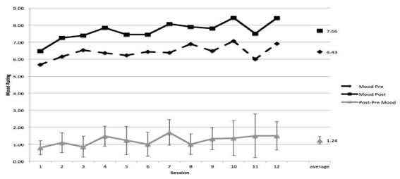
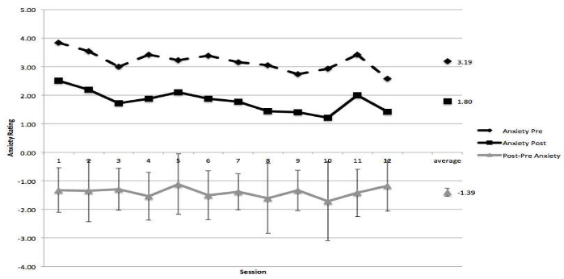

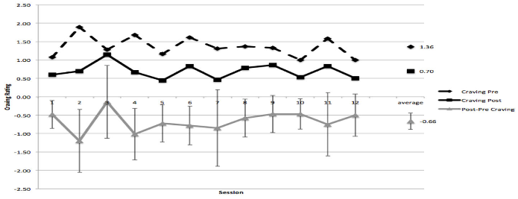
Mood
Exercise and Alcohol Use Disorder (AUD)
Anxiety
Cravings
Brown et al. (2016) Ment Health Phys Act. 11:1-6
Notes:
There is at least one study shown here that shows acute or a single bout of exercise decreases cravings for alcohol
And improves mood and anxiety in people with an alcohol use disorder

Slide 11
Exercise and Methamphetamine (MA) Use Disorder (MUD)
Reference | Sample | Ex Type/Dose | Outcomes
Dolezal et al., 2014 | 50 M (100%), 22 controls, 28 abstinent MA-dependent (14 Ex + 14 no Ex) | Endurance + resistance (ea 30m) 3 d/wk, 8 wks | ↑ EXERCISE VO₂ max, strength; body mass, BF, BMI
Haglund et al., 2015 Rawson et al. 2015a Rawson et al., 2015b | 135 M (70%), MA-dependent (69 Ex + 66 health education) | Endurance (30m)+resistance (15m) 3 d/wk, 8 wks | ↓ DEPRESSION, ↓ DEPRESSION/ANXIETY ↓ MA USE 1-, 3-, and 6-months post treatment
Robertson et al, 2016 | 19 M (53%) MA-dependent (10 Ex + 9 health education) | Endurance (30m)+resistance (15m) 3 d/wk, 8 wks | ↑ DOPAMINE striatal D2/D3 receptor availability
Salem et al, 2022 | 138 M (80%) MUD (71 Ex + 67 HE) | Endurance + resistance (60m) 3 d/wk, 8 wks | ↓ CRAVINGS & MA USE after discharge
Wang et al., 2015 | 24 M (83%) MA dependent (Ex + reading controls) | Endurance (20m) | ↓ CRAVING during, immediately following, and 50 min after the exercise session
Wang et al., 2016 | 92 M (87%) MA dependent (Ex + reading controls) | Endurance (20 m) | ↑ INHIBITORY CONTROL (IC)
Wang et al., 2017 | 50 M (78%) MA dependent (Ex + control group) | Endurance (30m) 3 d/wk, 12 wk | ↓ CRAVING/ ↑ IC more accuracy
Xu et al., 2022 | 60 M (100%) MA dependent (30 Ex + 30 non-Ex) | Endurance (30 m) + stretching (20m) 5 d/wk, 12 wk | ↑ QOL/MENTAL/PHYSICAL FITNESS social, mental and physical health
Zhu et al., 2016 | 60 M (100%) (30 Tai Chi + 30 standard care group) | Tai Chi intervention (30 m) 5 d/wk, 12 wk | ↑ QOL/BALANCE/BODY FAT
Zhang et al., 2018 | 103 M (77%) 68 MA-dependent (34 Ex, 34 non-Ex, 35 healthy controls) | Endurance (30 m) 3 d/wk, 12 wk | ↑ PROCESSING SPEED
Lindsay A (2024) ACSM Annual Meeting
Notes:
- in people with a methamphetamine use disorder, which is a stimulant,
Exercise has been shown to increase abstinence as well as decrease cravings, depression and anxiety
and improve fitness

Slide 12
Exercise and Opioid Use Disorders (OUD)
Only a few clinical trials in OUD
Anxiety
*
*
Abstinence
Depression
Wang D et al. (2014): PLoS ONE 9(10): e110728
Notes:
In summary, although there is a fair amount of evidence showing that exercise improves abstinence and decreases anxiety & depression in people with SUD collectively
we do not currently have enough large, well done studies in people with opioid use disorders and many other specific substances to draw conclusions about whether or not there are differences in effects by types of substances
We also do not have enough evidence to determine if exercise can improve cravings , quality of life and other outcomes for these specific substances

